Slide 1
Creating Multi Processor Solutions
Course Workbook

Slide 2
Table of Contents
About this Workbook | Page 3
Pre-Lab: Workshop Pre-requisites | Page 4
Lab 2: Creating Multi Processor Solutions | Page 7

Slide 3
About this Workbook
The contents of this workbook are created by Adiuvo Engineering & Training, Ltd.
If you have any questions about the contents, or need assistance, please contact Adam Taylor at adam@adiuvoengineering.com.

Slide 4
Pre-Lab Creating Multi Processor Solutions

Slide 5
Required Hardware
Pre-Lab
ArtyZ7-20
Usb cable

Slide 6
Downloads and Installations
Pre-Lab
Step 1 – Download and install the following at least 1 day prior to the workshop. This may take a significant amount of time and drive space.
Watch the video available here to show how to configure the installation
Vitis 2021.1 | Download

Slide 7
Lab 2 Project creation & Flow

Slide 8
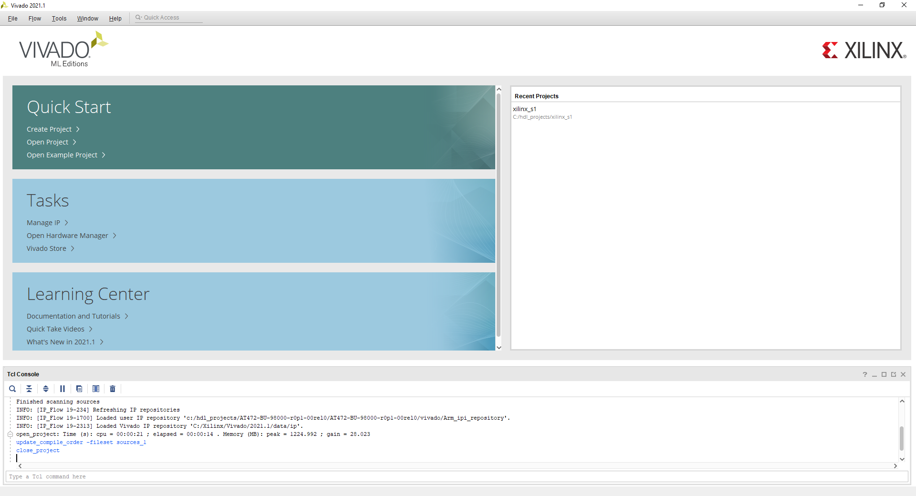
Lab 2: Understanding Vitis Project creation & Flow
Lab 2
Step 1 – Open Vivado 2021.1 – Open the project from session one

Slide 9
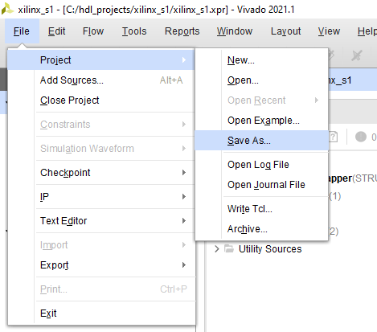
Lab 2: Understanding Vitis Project creation & Flow
Lab 2
Step 2 – From File->Project select save as and name it session two

Slide 10
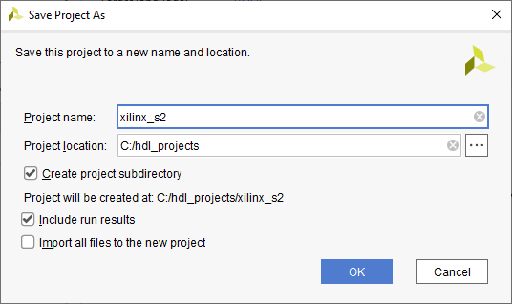
Lab 2: Understanding Vitis Project creation & Flow
Lab 2
Step 3 – From File->Project select save as and name it session two

Slide 11
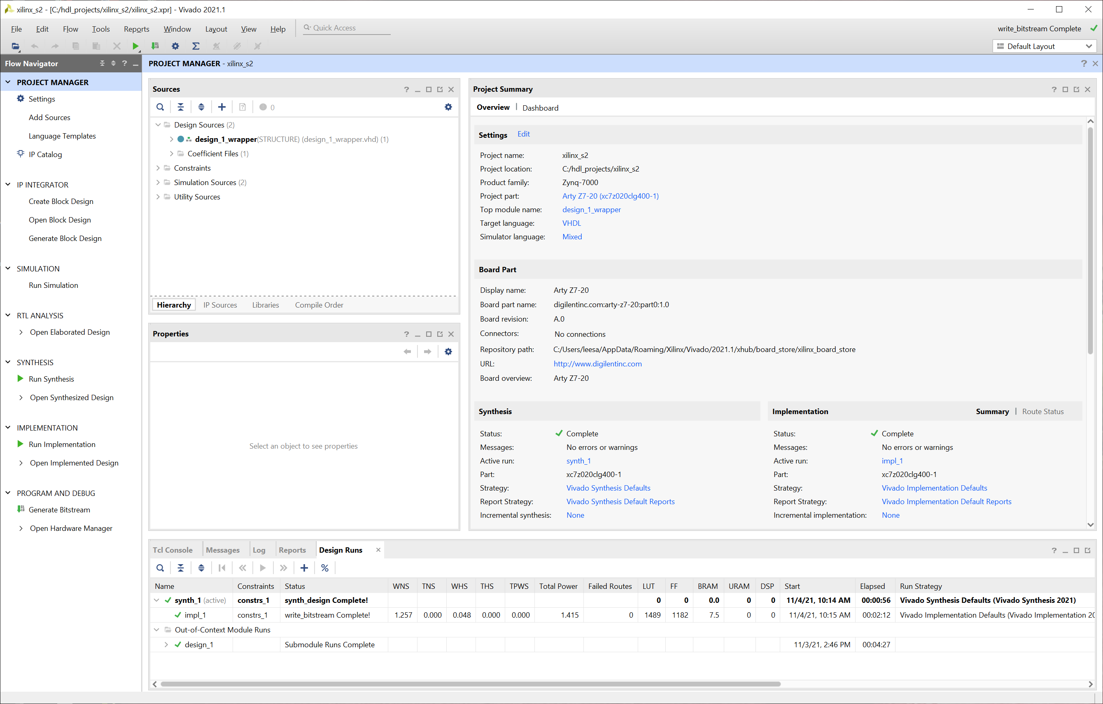
Lab 2: Understanding Vitis Project creation & Flow
Lab 2
Step 4 – Open the Block Diagram

Slide 12
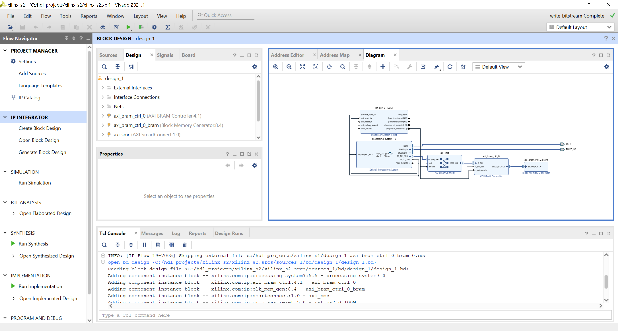
Lab 2: Understanding Vitis Project creation & Flow
Lab 2
Step 5 – Un dock the block diagram, and maximize it

Slide 13
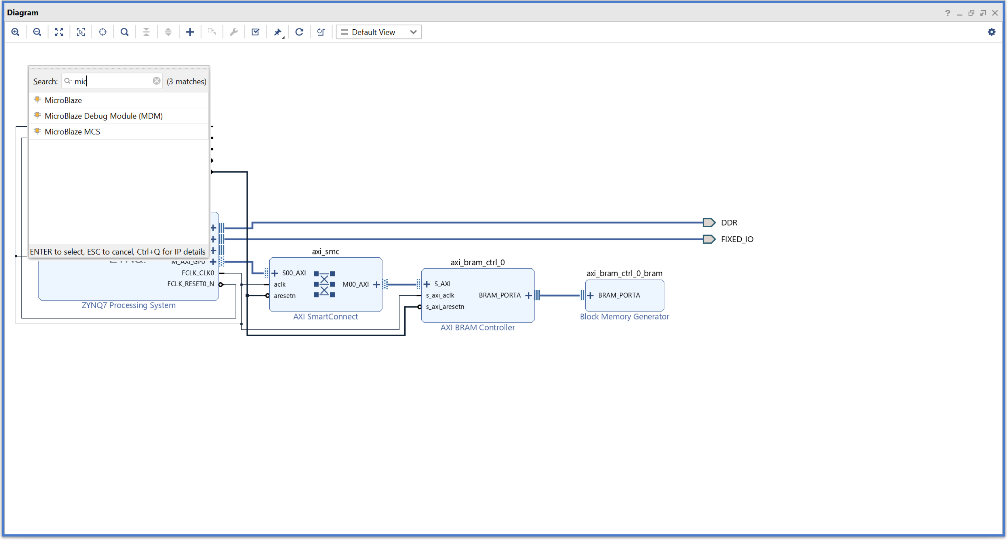
Lab 2: Understanding Vitis Project creation & Flow
Lab 2
Step 6 – Click on + and in the search bar, type microblaze – double click on the MicroBlaze IP to add it to IP Integrator

Slide 14
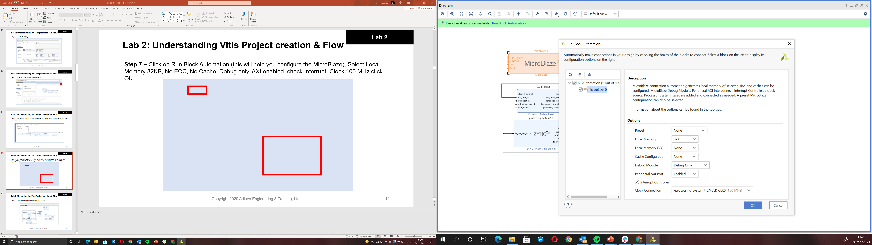
Lab 2: Understanding Vitis Project creation & Flow
Lab 2
Step 7 – Click on Run Block Automation (this will help you configure the MicroBlaze), Select Local Memory 32KB, No ECC, No Cache, Debug only, AXI enabled, check Interrupt, Clock 100 MHz click OK

Slide 15
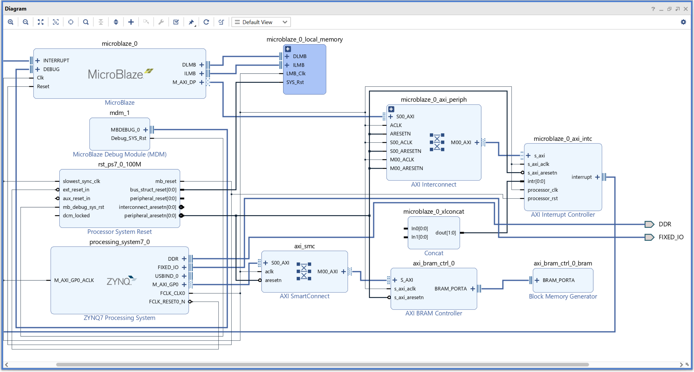
Lab 2: Understanding Vitis Project creation & Flow
Lab 2
Step 8 – Once the automation finishes, click on the + symbol

Slide 16
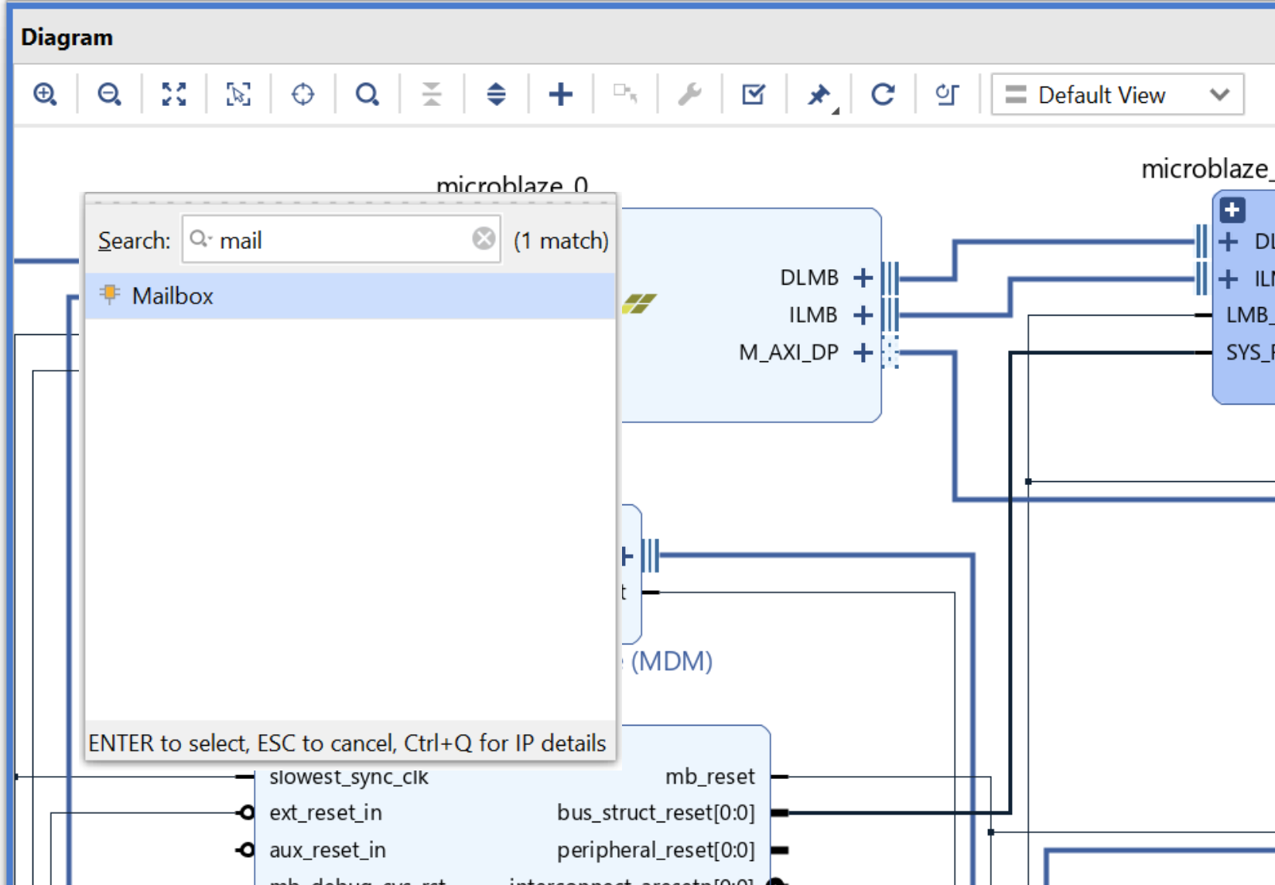
Lab 2: Understanding Vitis Project creation & Flow
Lab 2
Step 9 – Type in Mailbox, double click and add it to the diagram

Slide 17
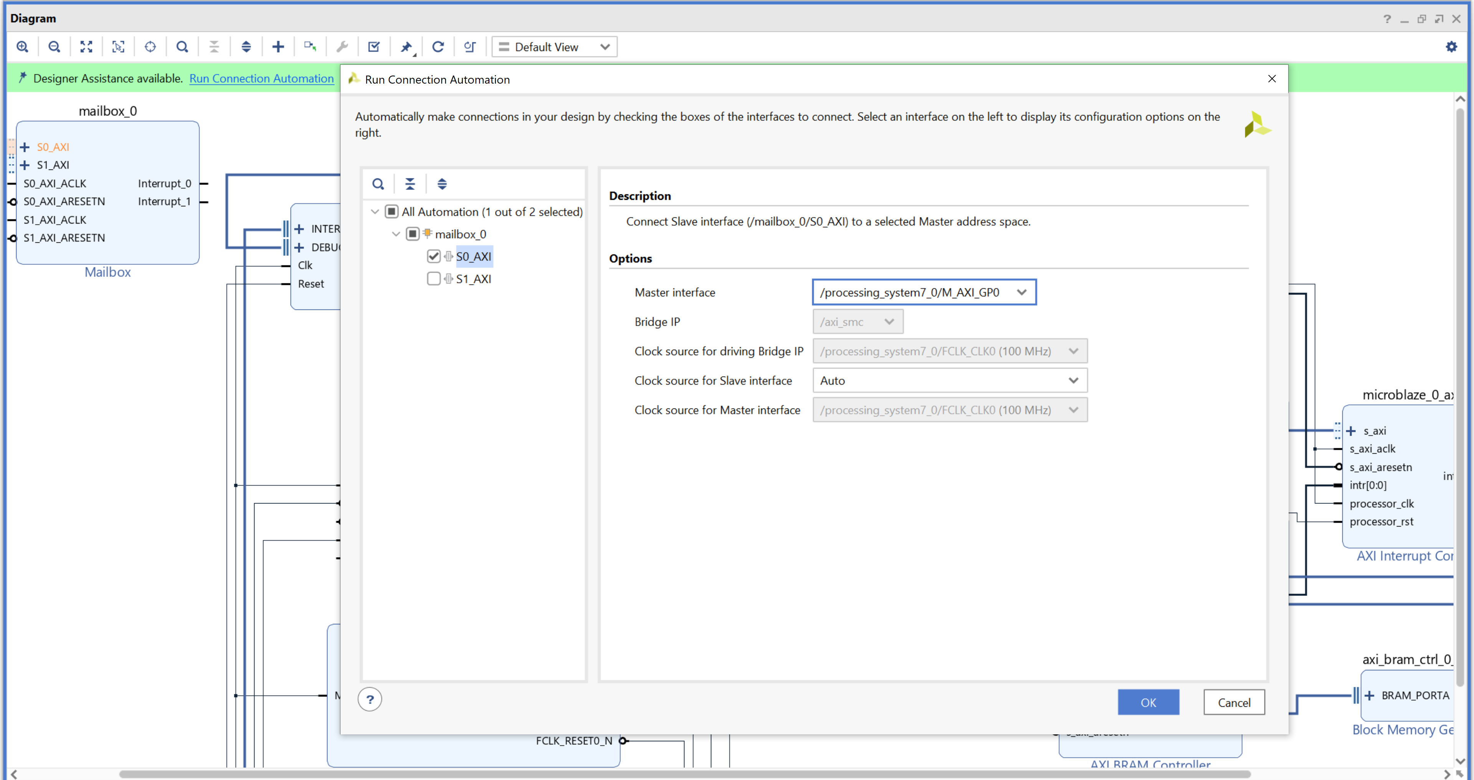
Lab 2: Understanding Vitis Project creation & Flow
Lab 2
Step 10 – Click on Run Connection Automation, Check Mailbox. For S0_AXI set master interface to M_AXI_GP0 on the Processing System

Slide 18
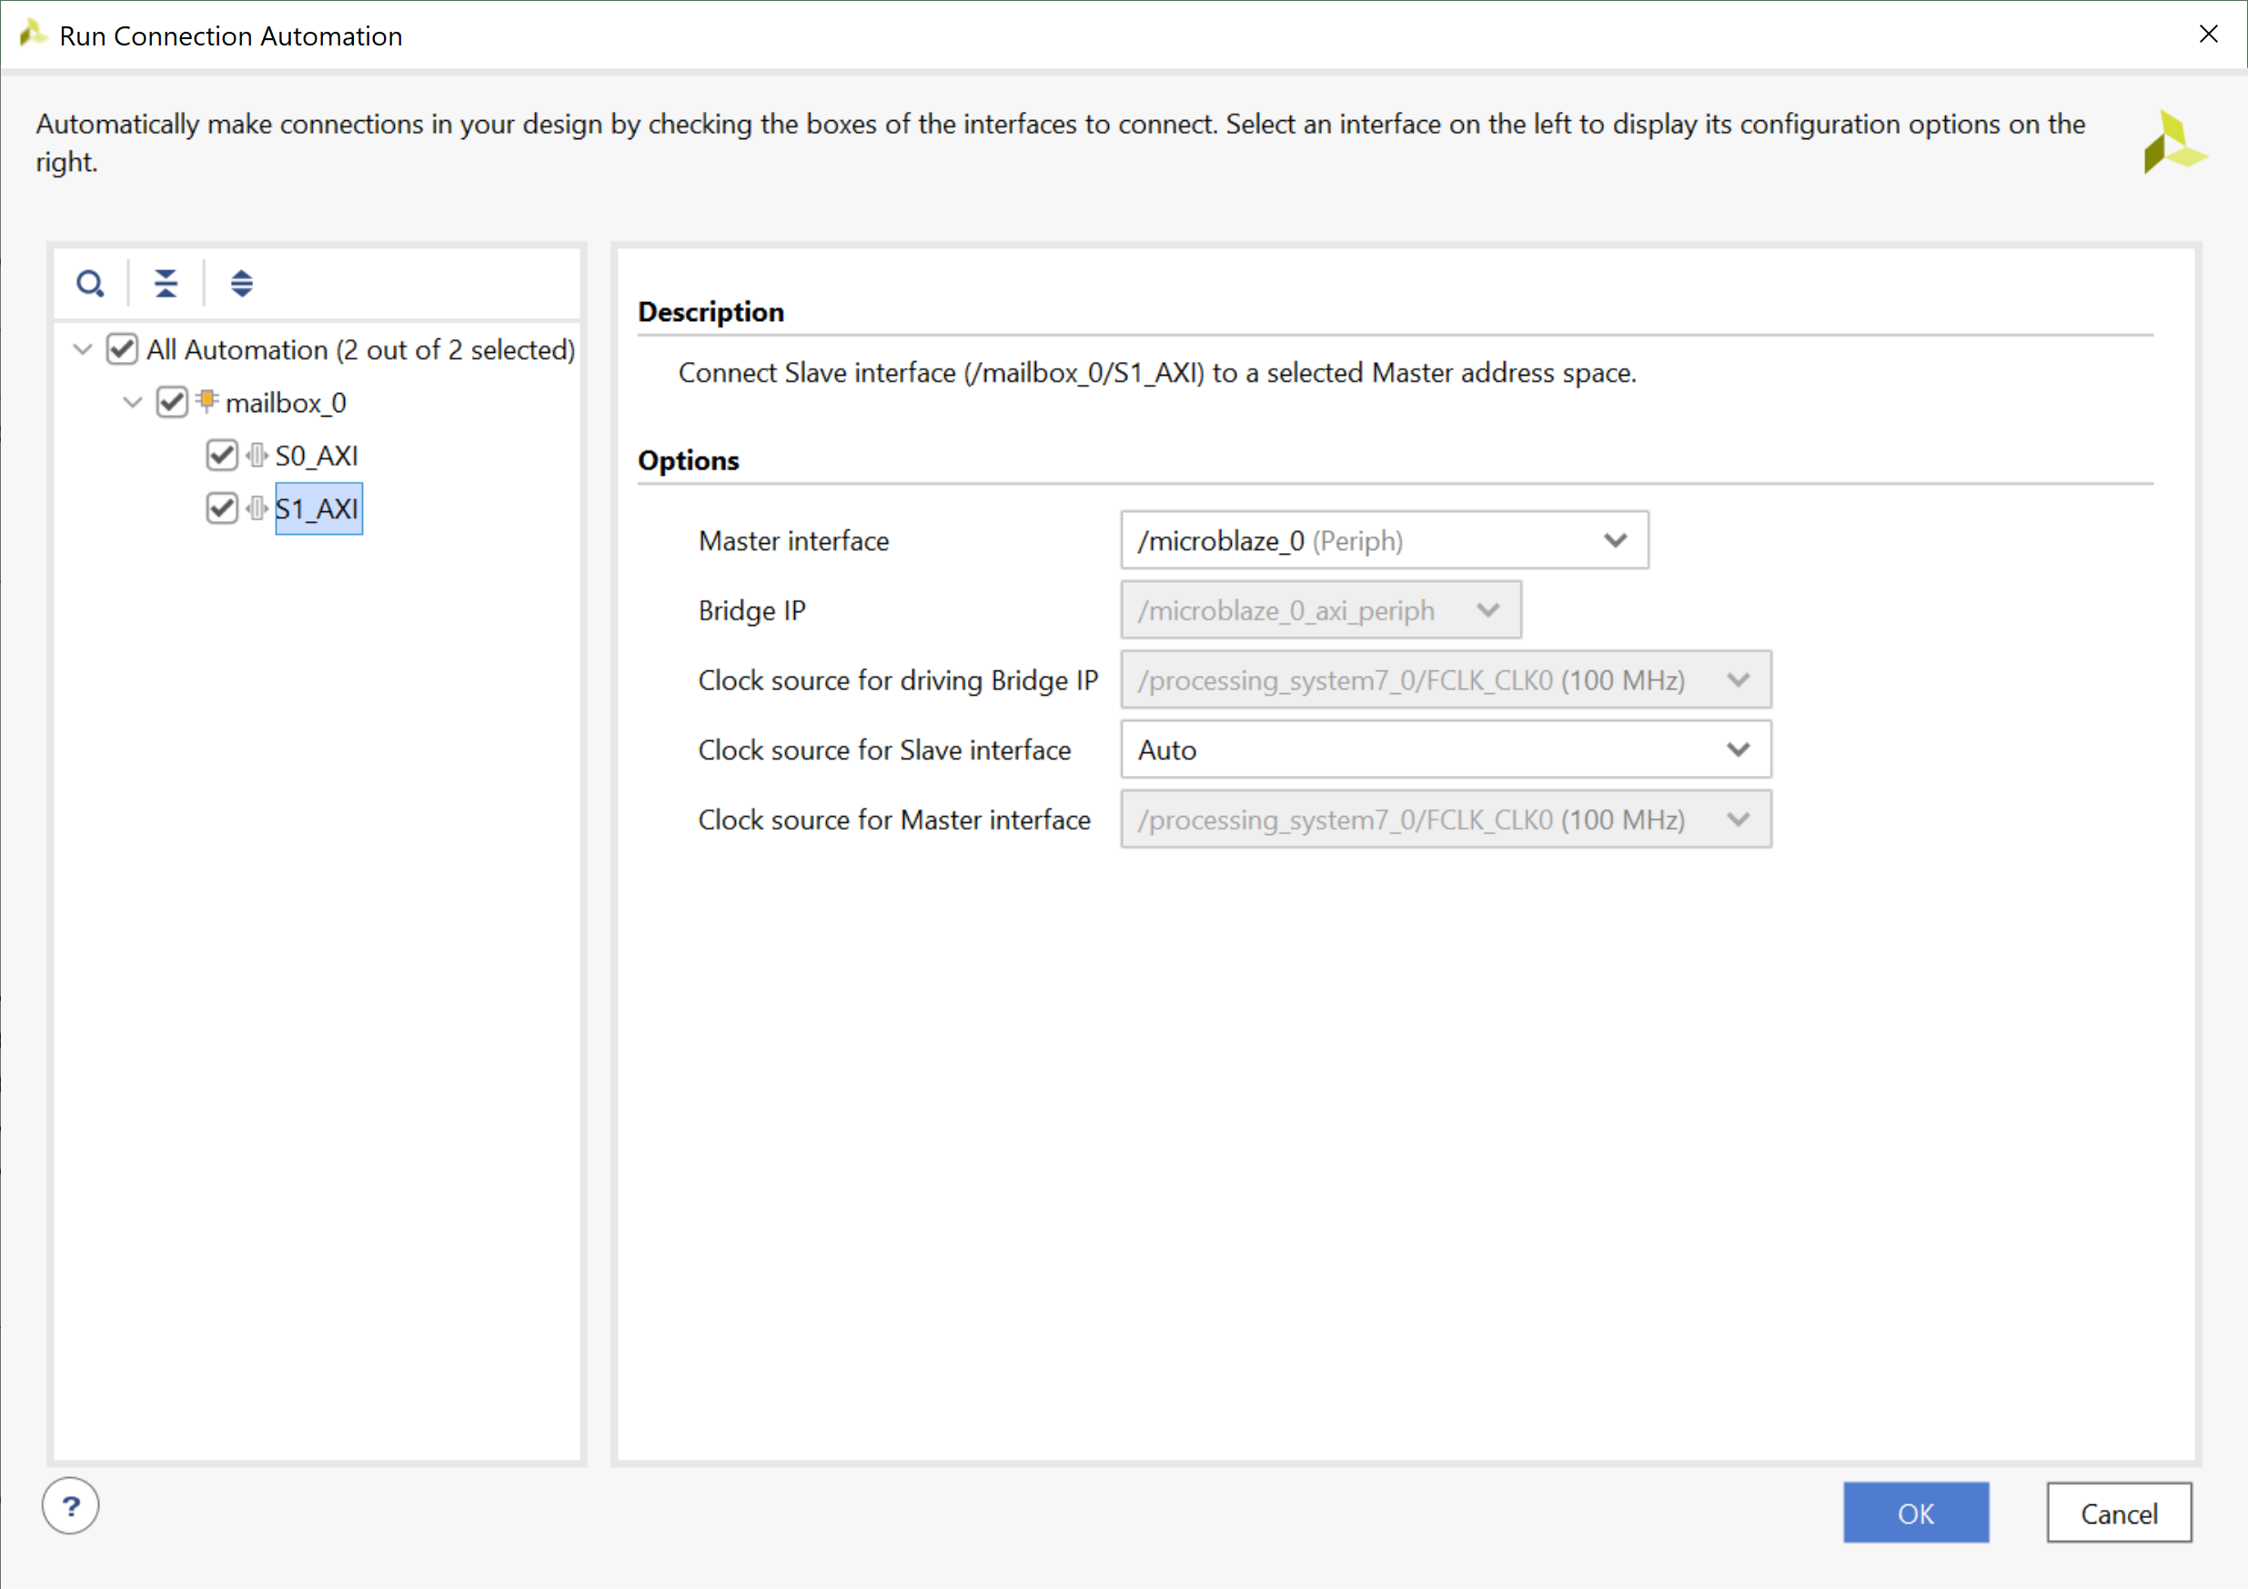
Lab 2: Understanding Vitis Project creation & Flow
Lab 2
Step 11 – Click on S1_AXI and select the master interface to be the MicroBlaze system.

Slide 19
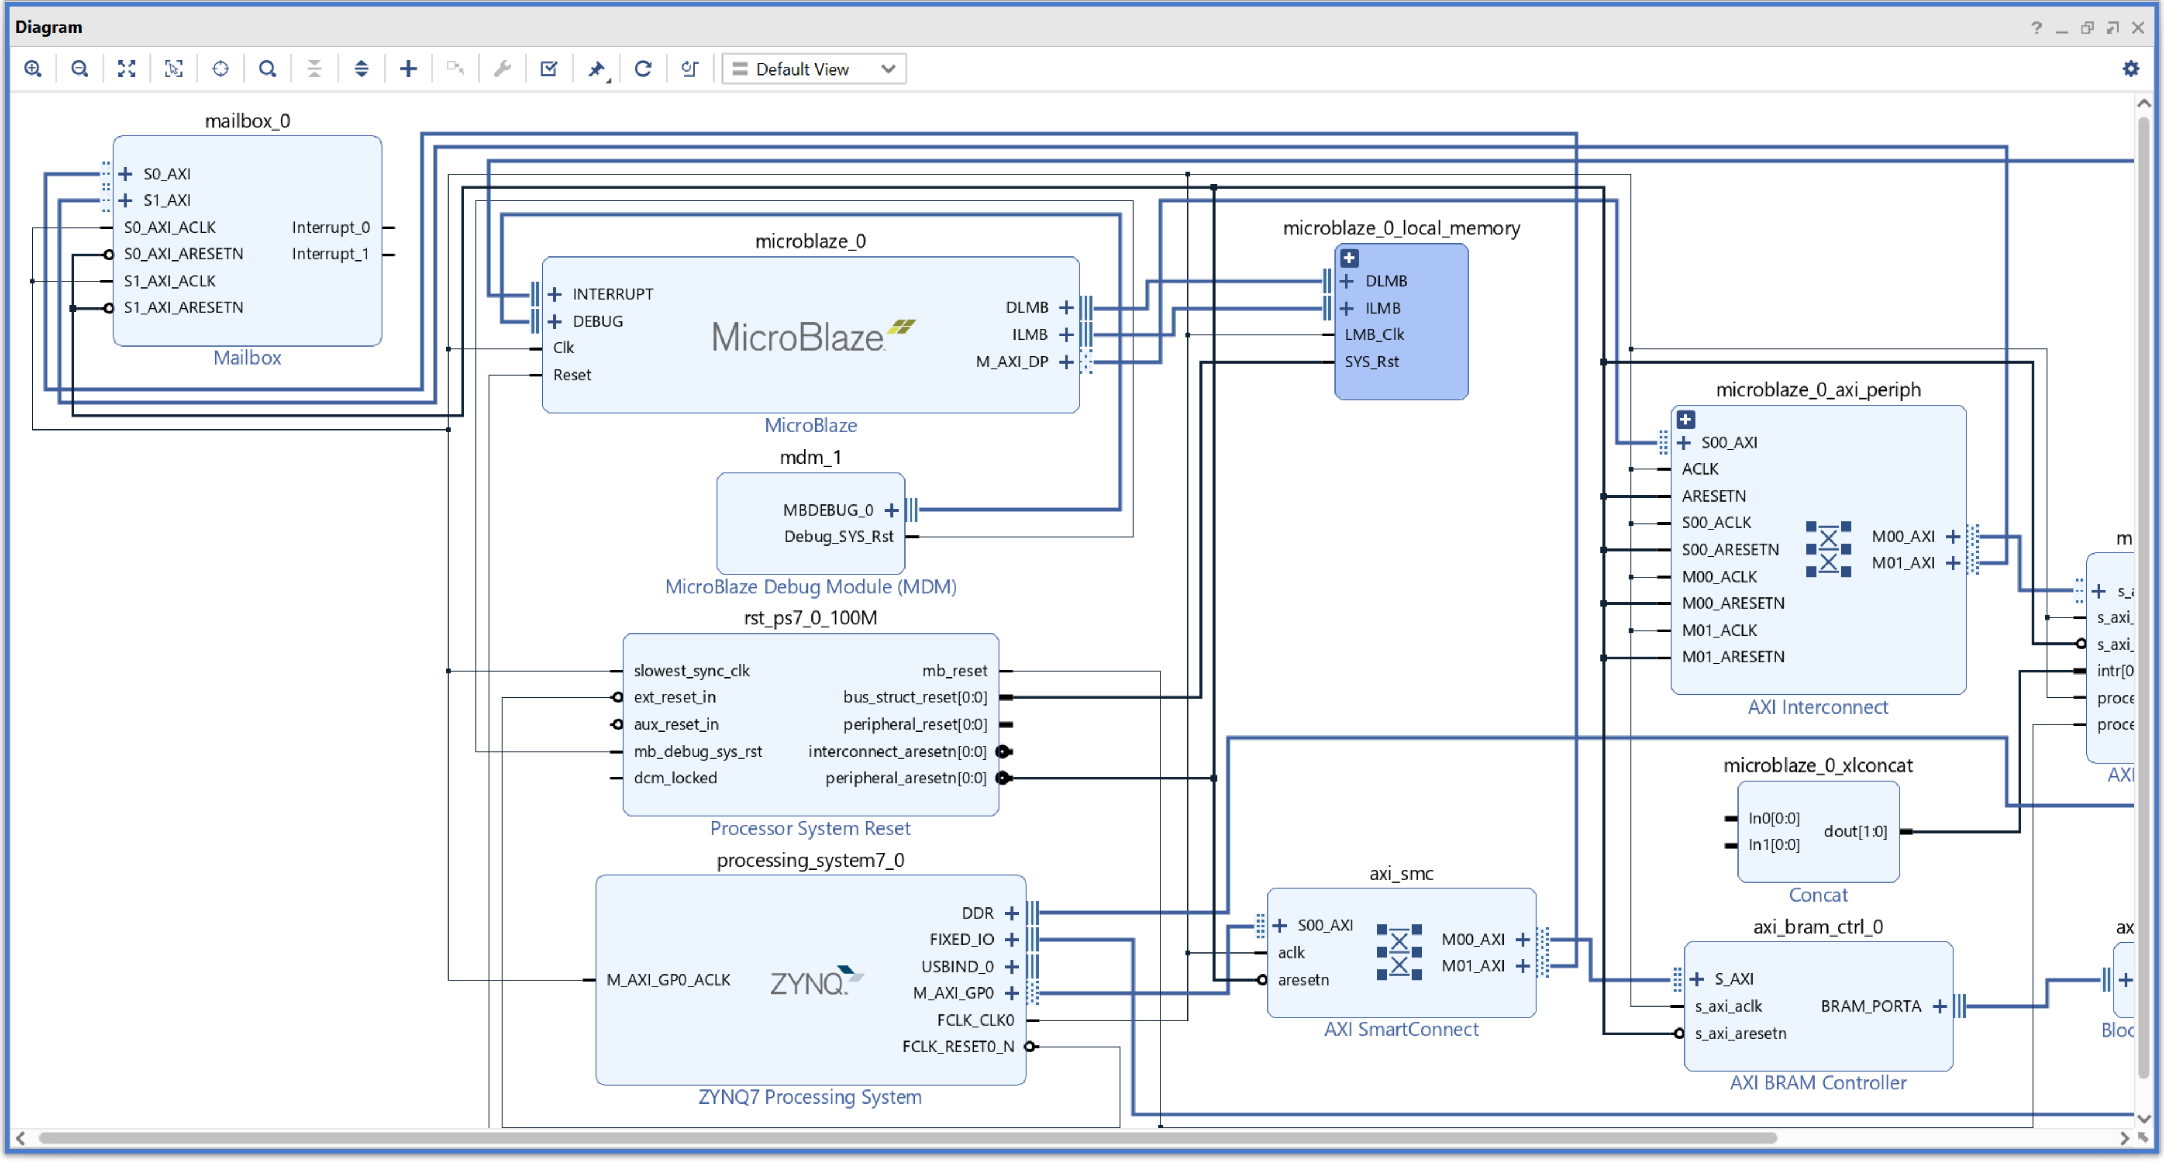
Lab 2: Understanding Vitis Project creation & Flow
Lab 2
Step 12 – Click the processing system

Slide 20
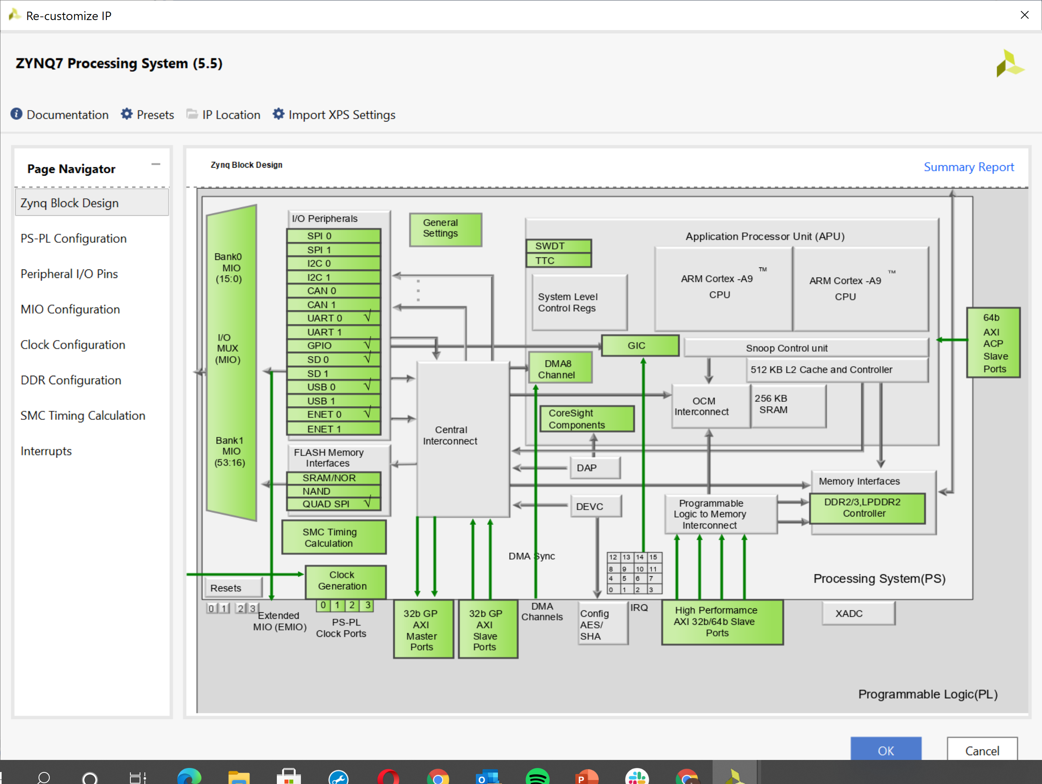
Lab 2: Understanding Vitis Project creation & Flow
Lab 2
Step 13 – Click interrupts

Slide 21
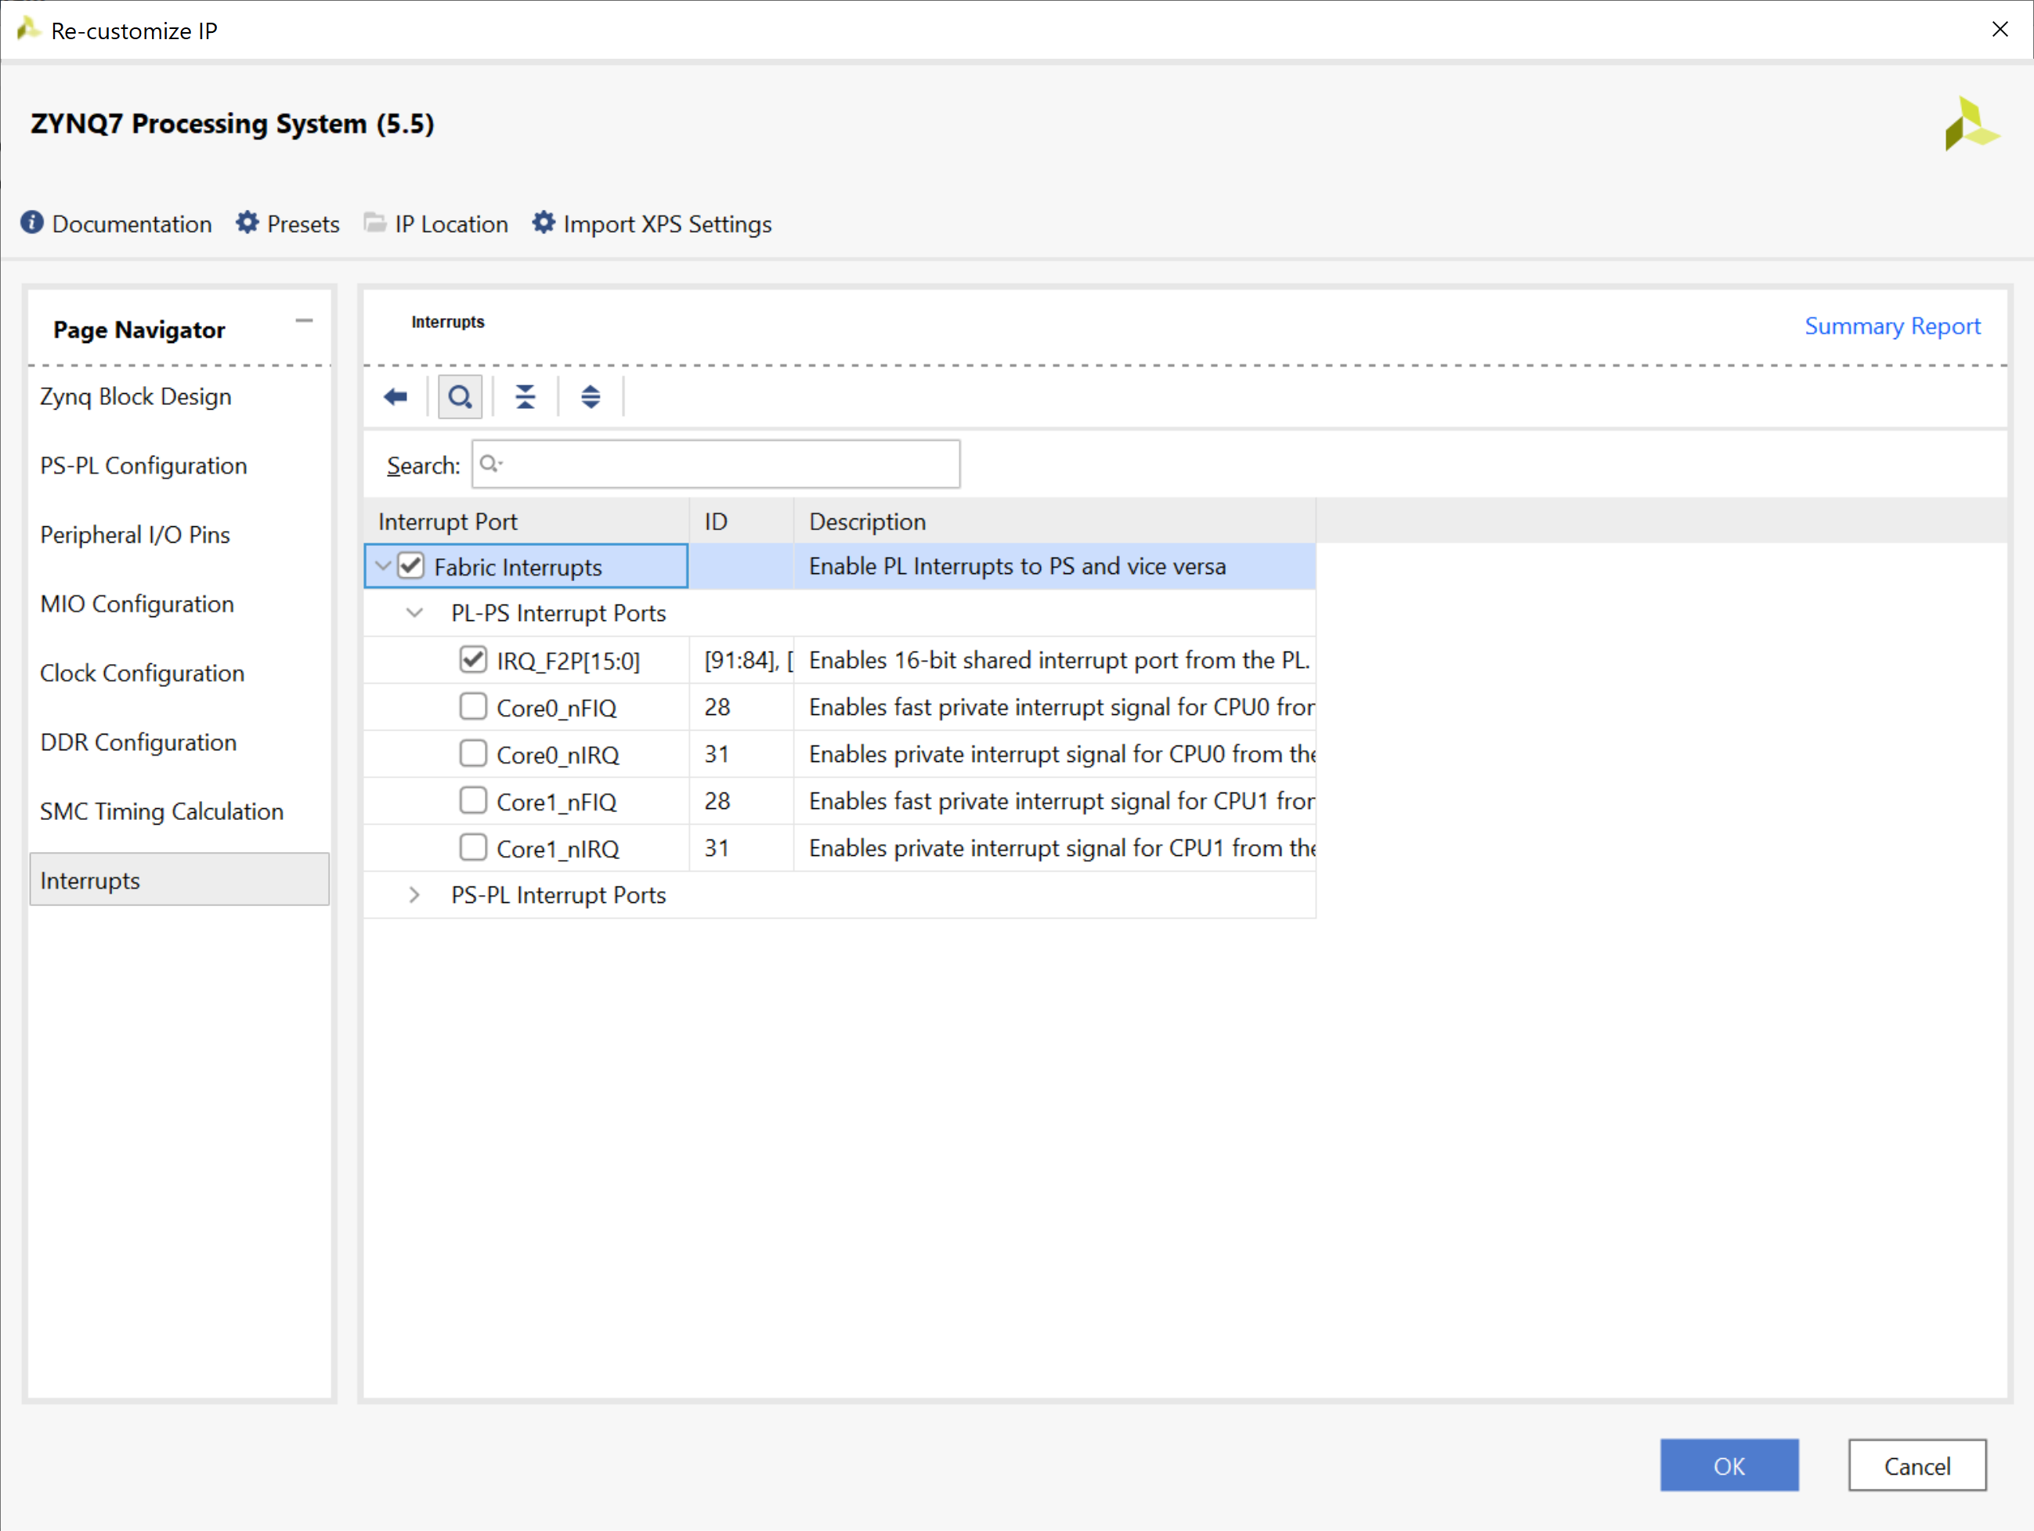
Lab 2: Understanding Vitis Project creation & Flow
Lab 2
Step 14 – Click interrupts, select Fabric Interrupts, IRQ_R2P and click OK

Slide 22
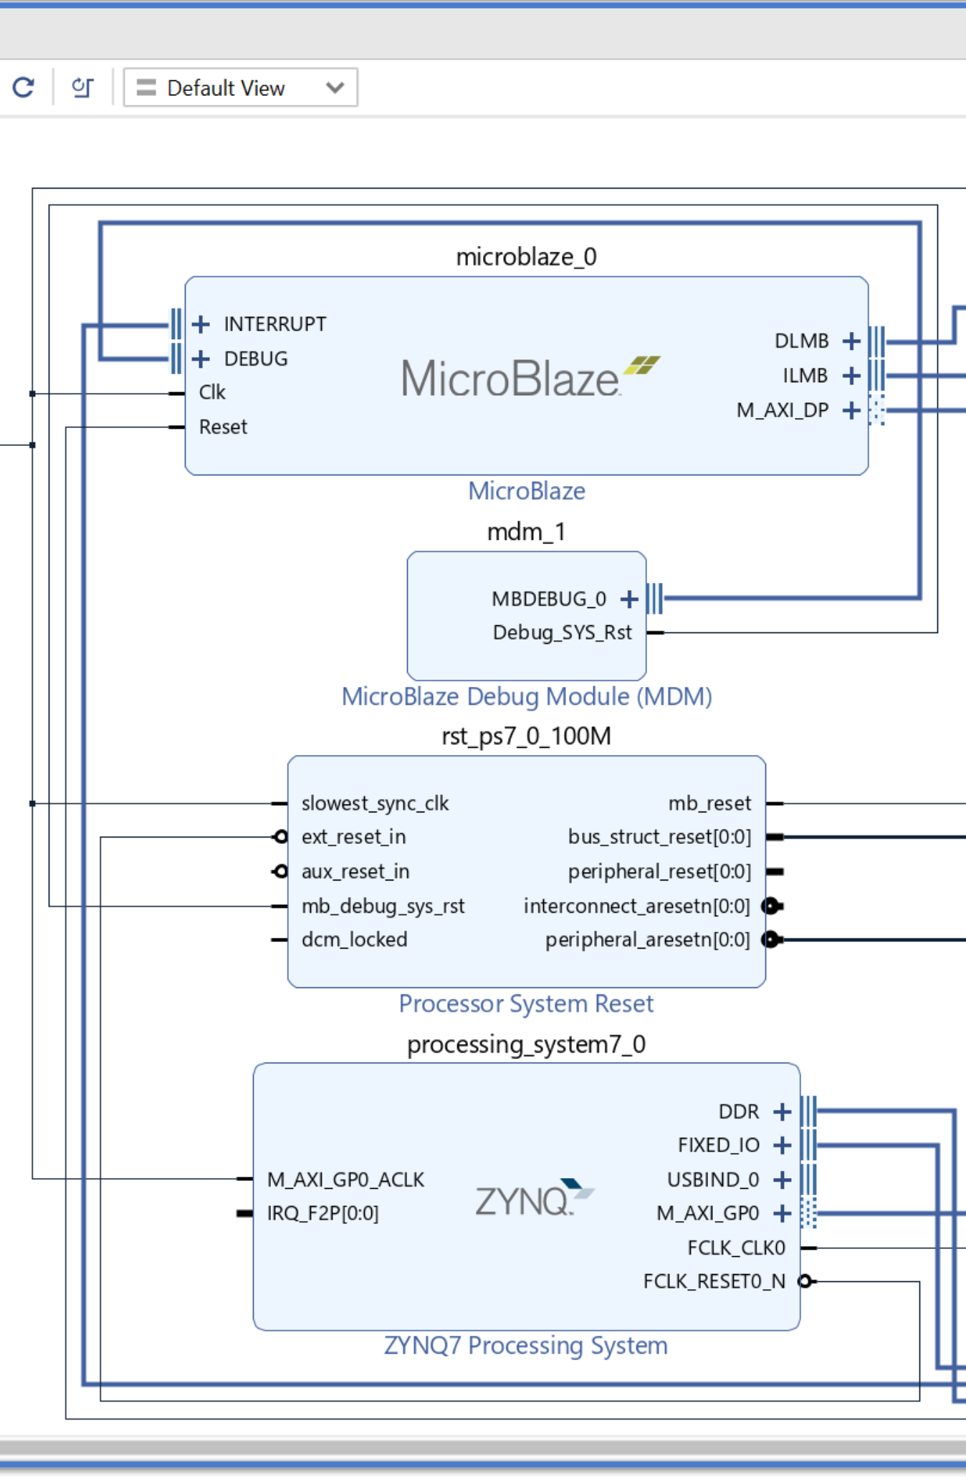
Lab 2: Understanding Vitis Project creation & Flow
Lab 2
Step 15 – This will update the processing system block to include IRQ_F2P interrupt

Slide 23
Lab 2: Understanding Vitis Project creation & Flow
Lab 2
Step 16 – Click +

Slide 24
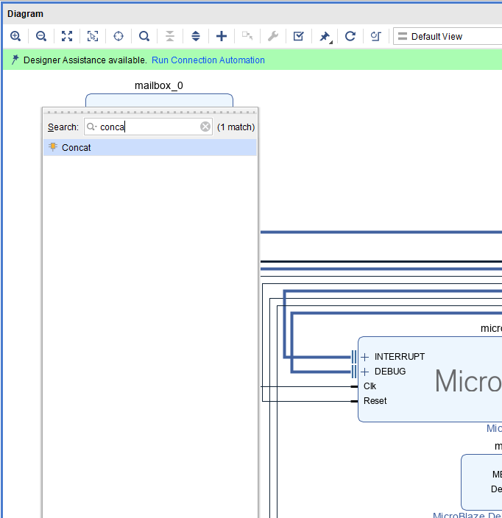
Lab 2: Understanding Vitis Project creation & Flow
Lab 2
Step 17 – Type Concat and double click to add in the concatenation block

Slide 25
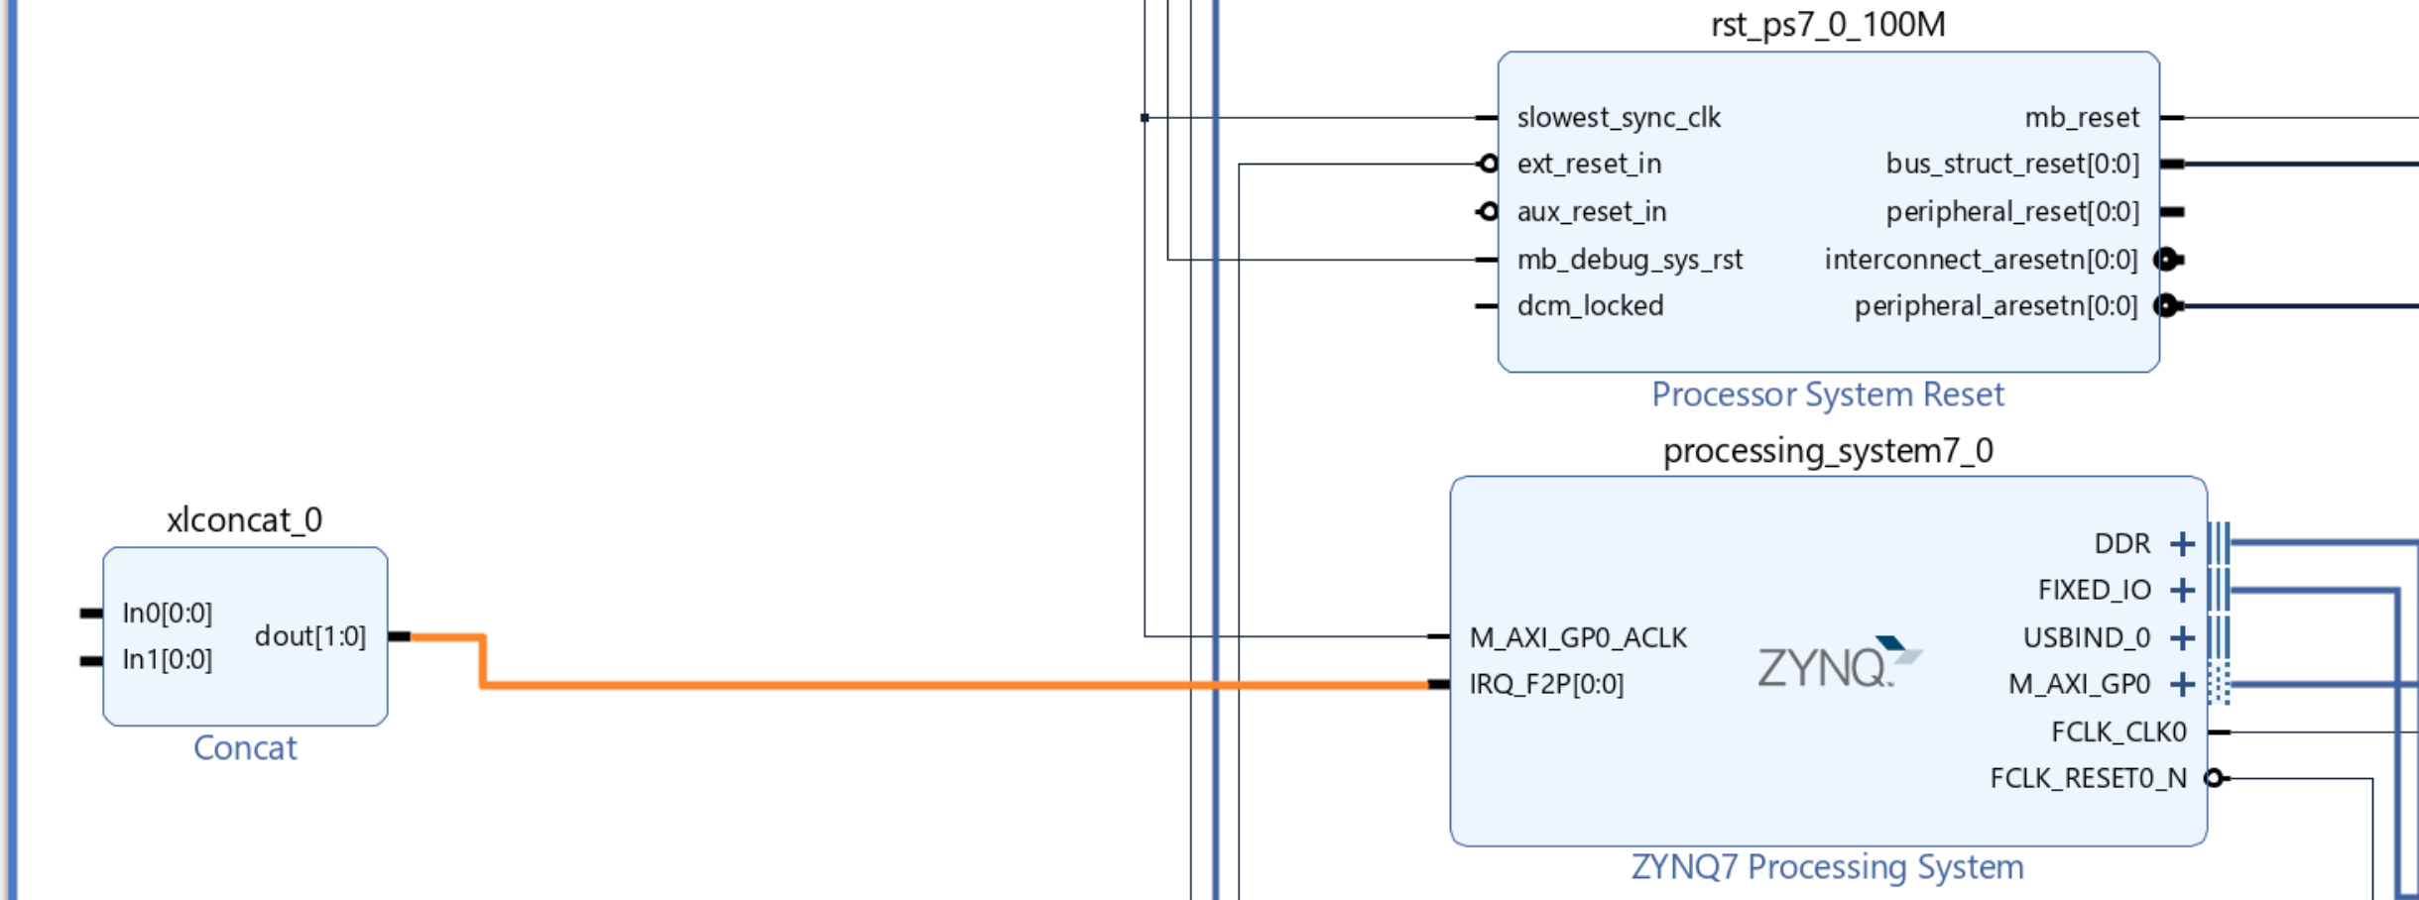
Lab 2: Understanding Vitis Project creation & Flow
Lab 2
Step 18 – Connect the Concat Block to the IRQ_F2P input

Slide 26
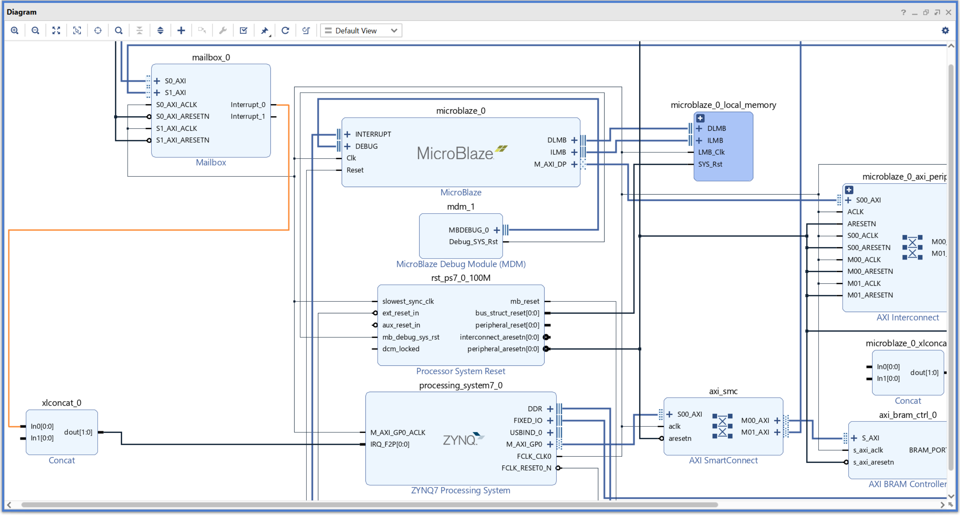
Lab 2: Understanding Vitis Project creation & Flow
Lab 2
Step 19 – Connect the interrupt one output from the mailbox to the concat block just added.

Slide 27
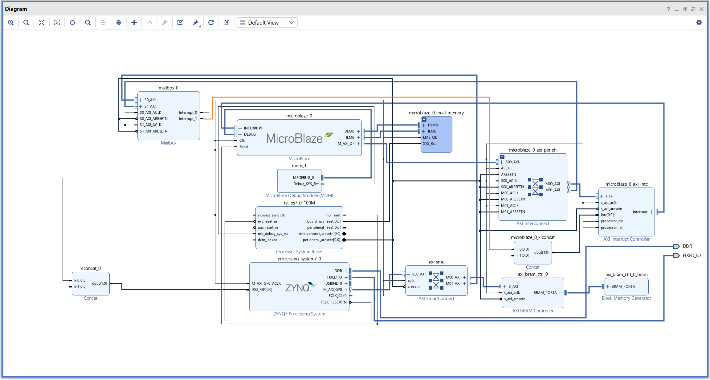
Lab 2: Understanding Vitis Project creation & Flow
Lab 2
Step 20 – Connect the interrupt two output from the mailbox to the concat block for the MicroBlaze.

Slide 28
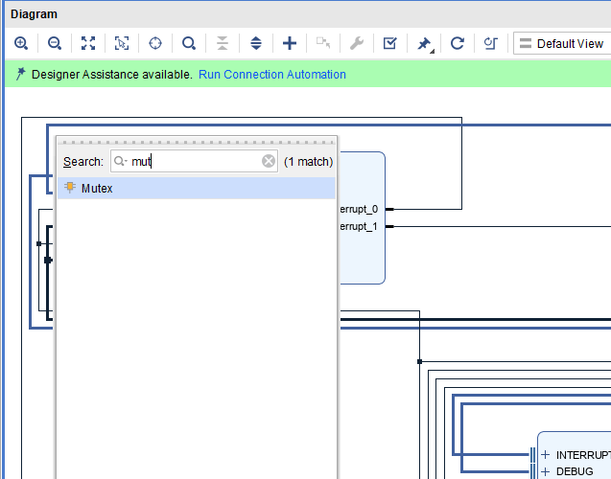
Lab 2: Understanding Vitis Project creation & Flow
Lab 2
Step 21 – Click on + and type Mutex, double click to add it in to IP integrator.

Slide 29
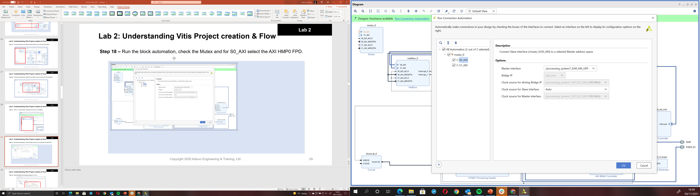
Lab 2: Understanding Vitis Project creation & Flow
Lab 2
Step 22 – Run the block automation, check the Mutex and for S0_AXI select the M_AXI_GPO.

Slide 30
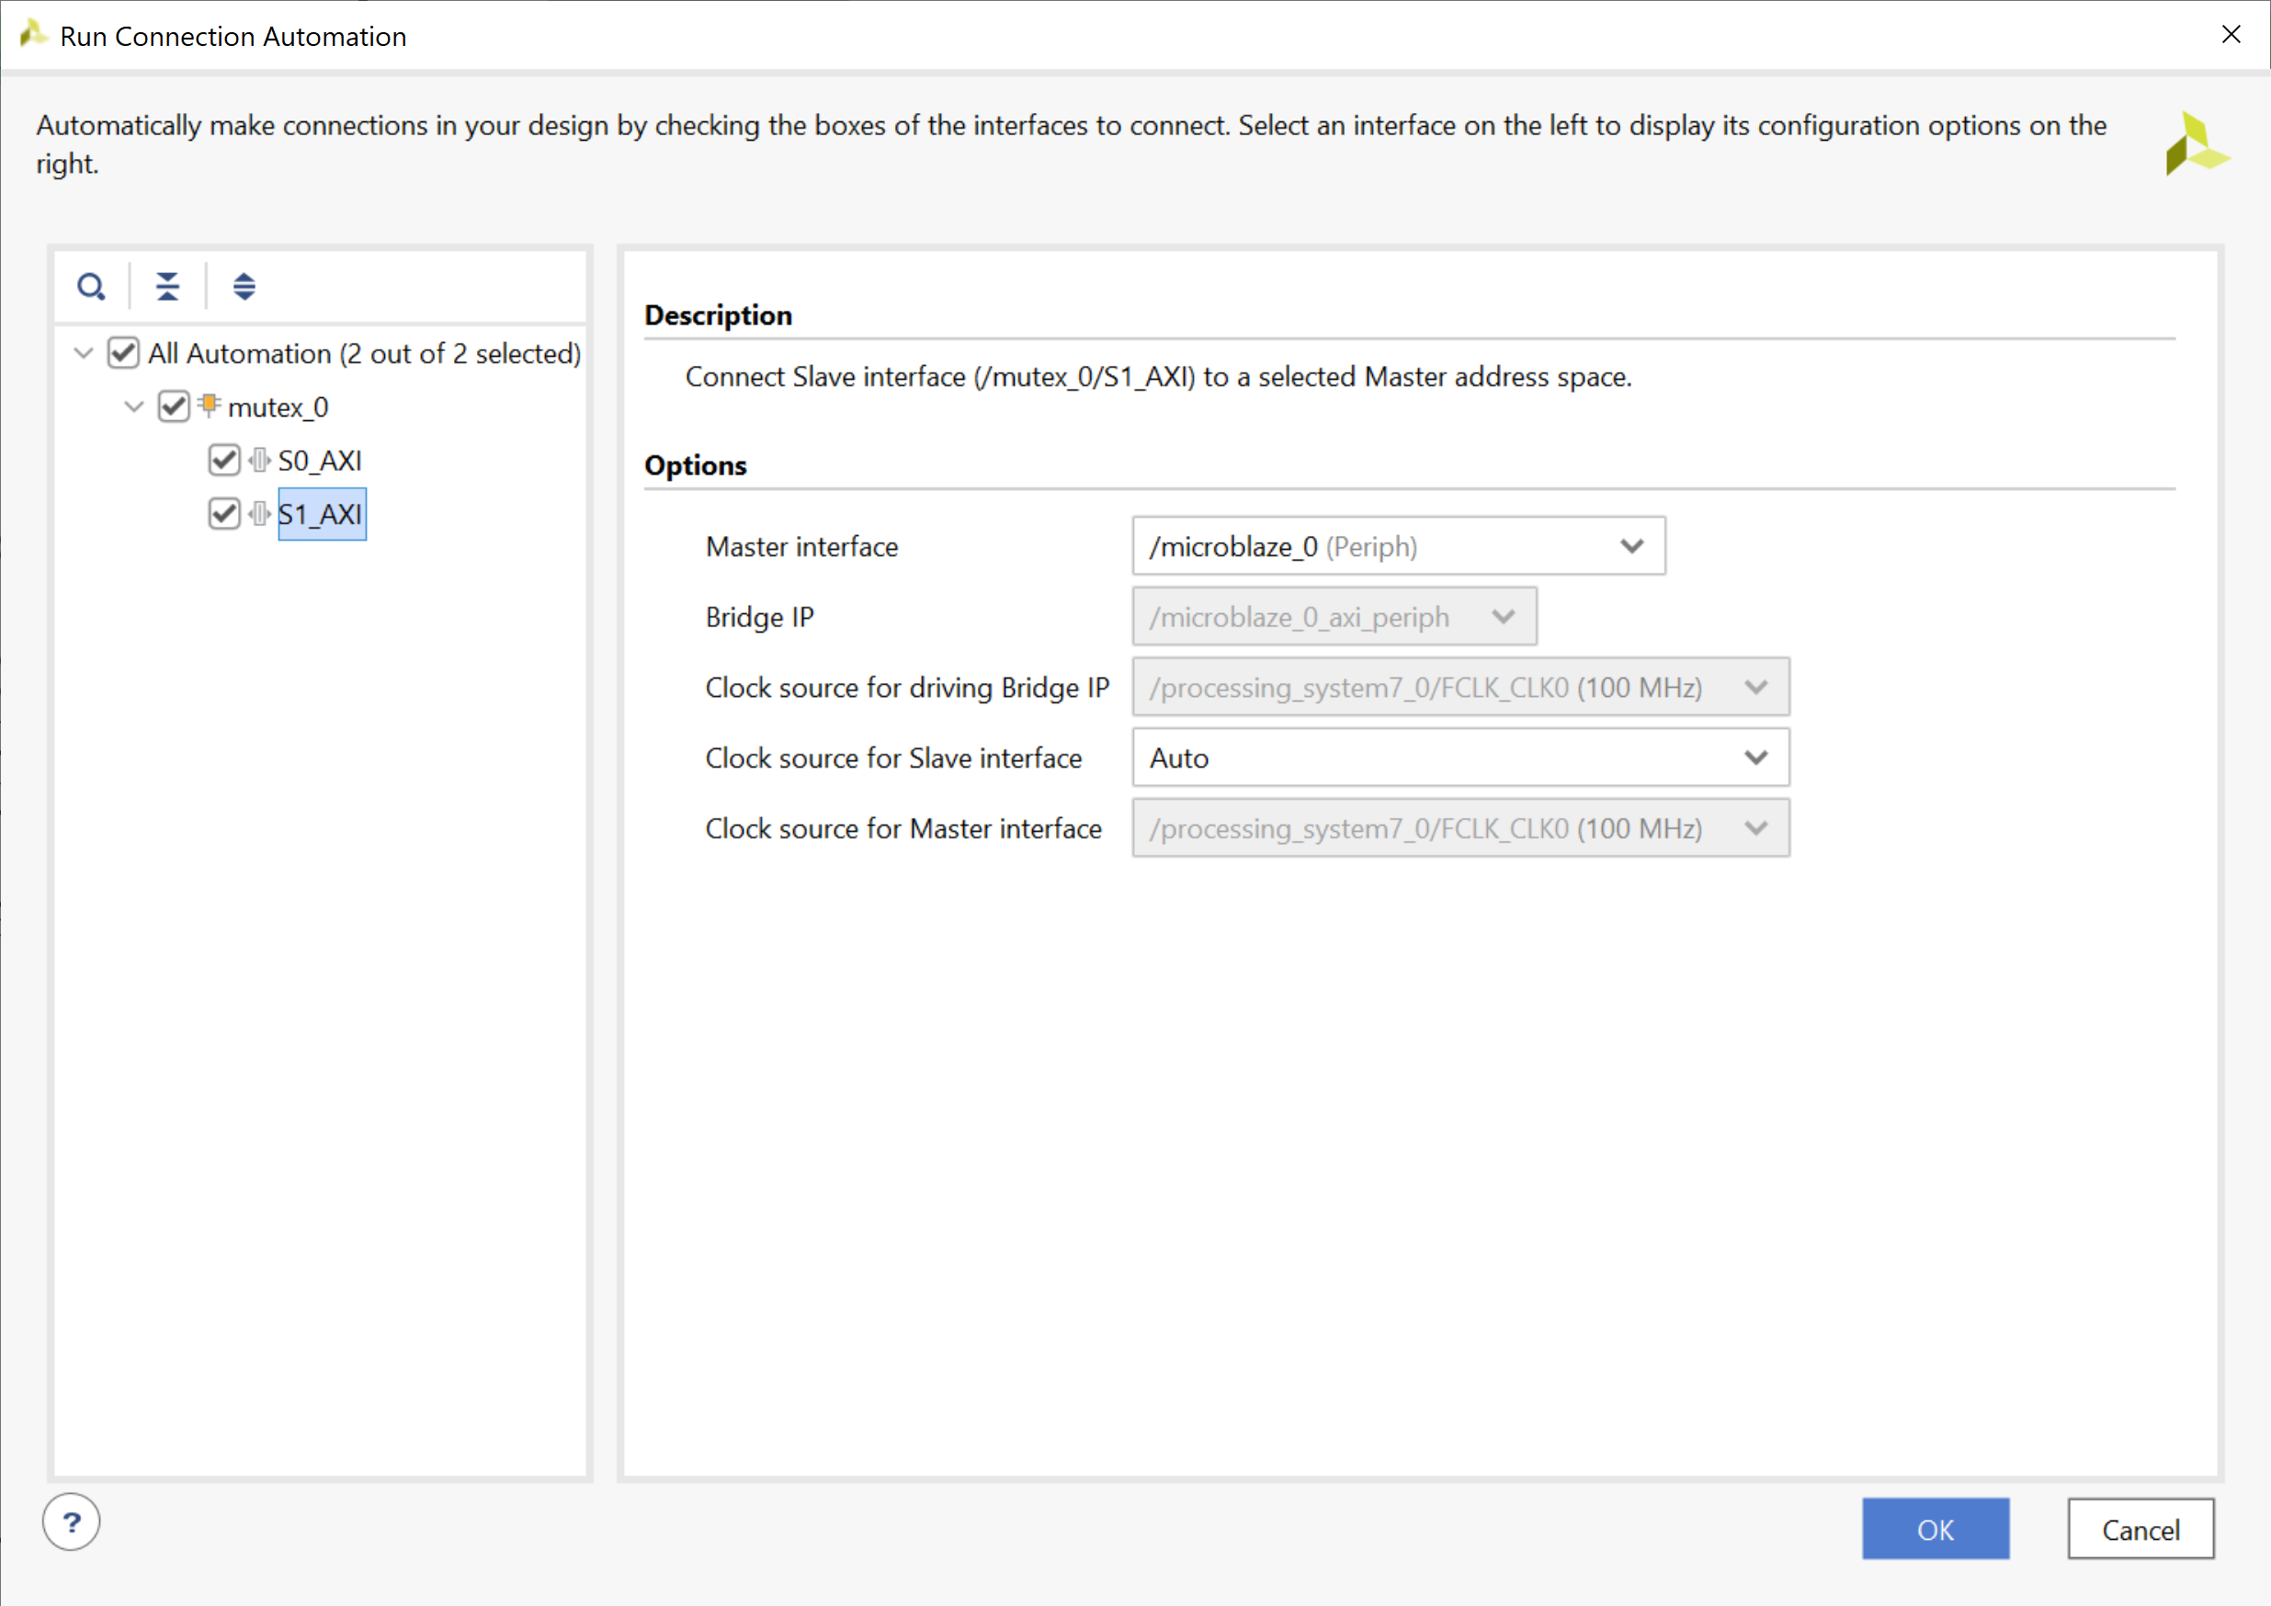
Lab 2: Understanding Vitis Project creation & Flow
Lab 2
Step 23 – Select MicroBlaze for the Master Interface on S1 AXI.

Slide 31
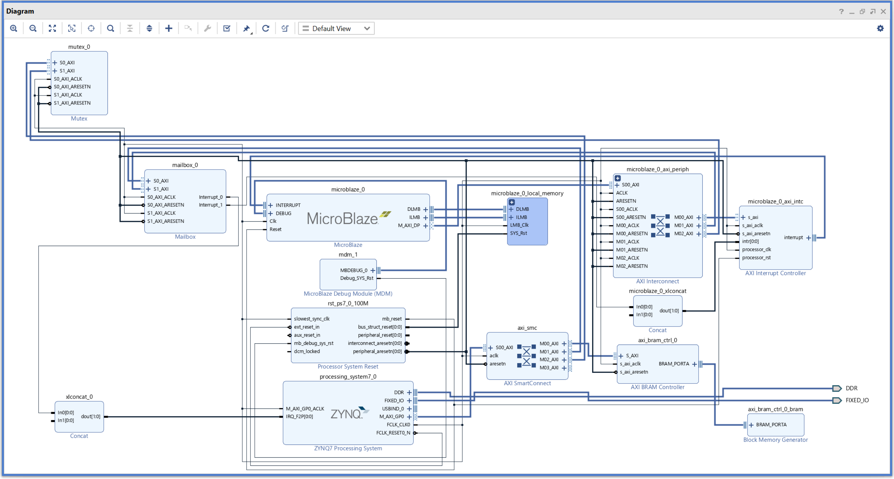
Lab 2: Understanding Vitis Project creation & Flow
Lab 2
Step 24 – Hit the regenerate layout button to create the layout as below

Slide 32
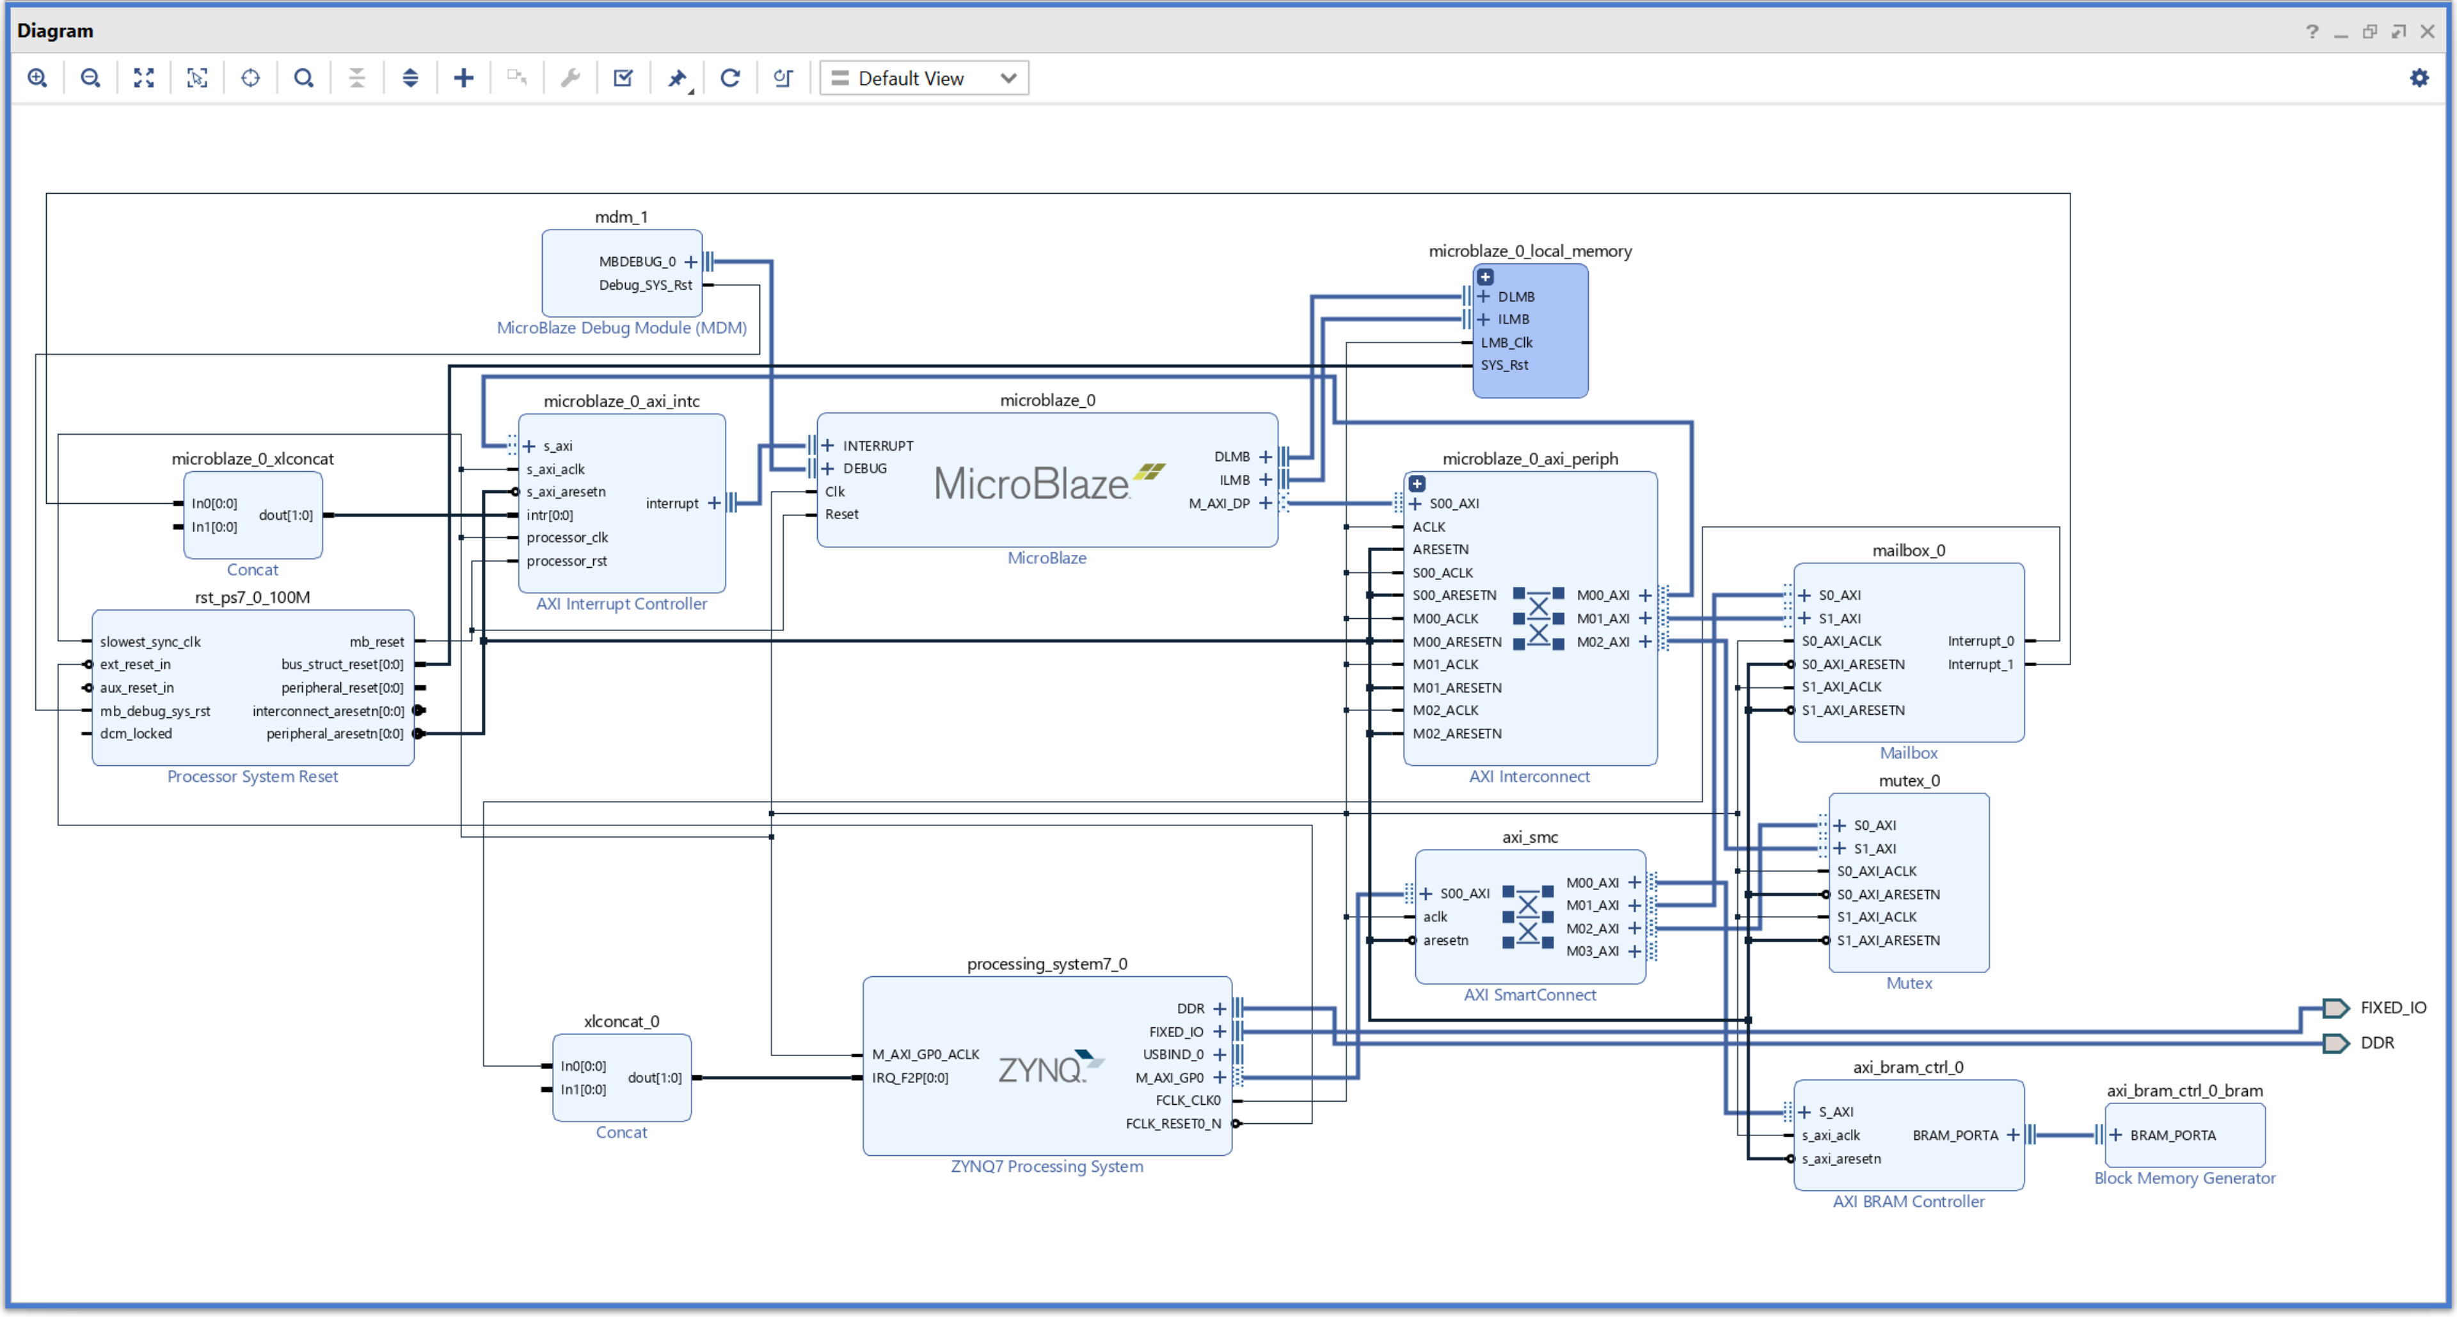
Lab 2: Understanding Vitis Project creation & Flow
Lab 2
Step 25 – Validate the design

Slide 33
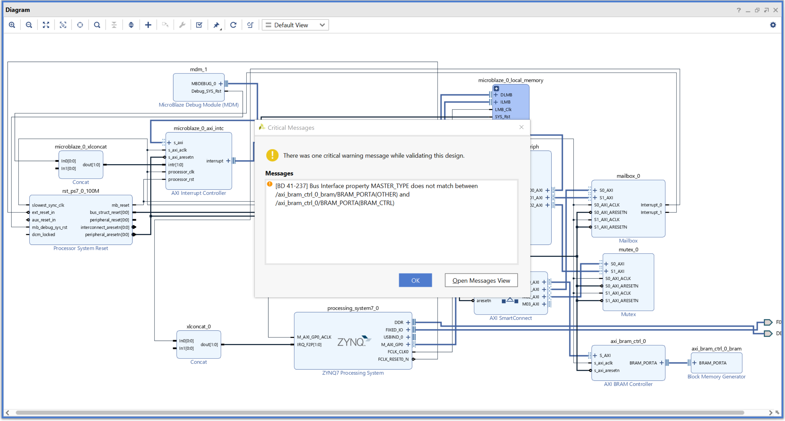
Lab 2: Understanding Vitis Project creation & Flow
Lab 2
Step 26 – The only warning messages should be those seen before

Slide 34
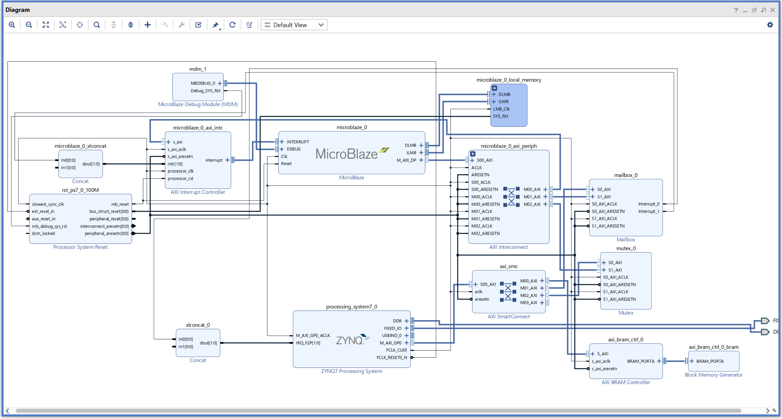
Lab 2: Understanding Vitis Project creation & Flow
Lab 2
Step 27 – Re Dock the IP Integrator window

Slide 35
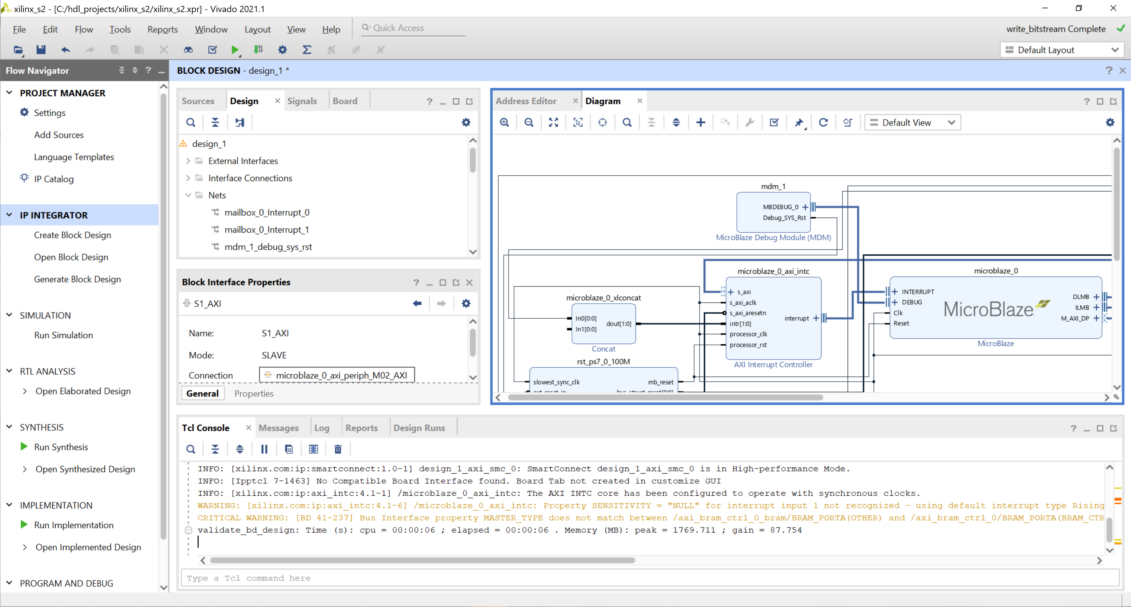
Lab 2: Understanding Vitis Project creation & Flow
Lab 2
Step 28 – Save the design and then re generate the bit stream

Slide 36
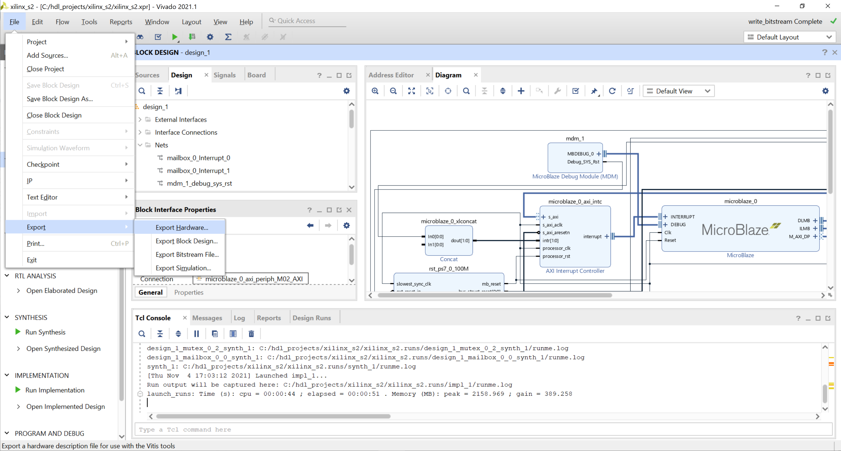
Lab 2: Understanding Vitis Project creation & Flow
Lab 2
Step 29 – Once the bitstream is complete, export the bit stream with the bit file to the project directory

Slide 37
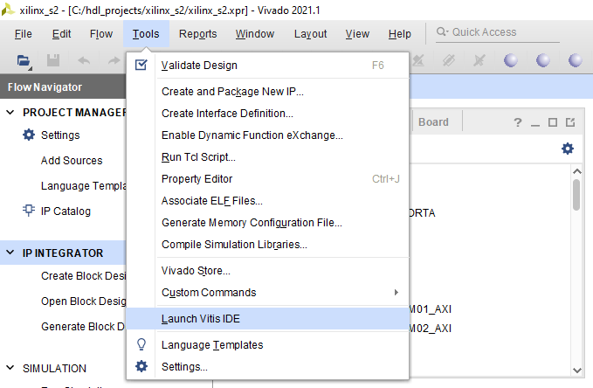
Lab 2: Understanding Vitis Project creation & Flow
Lab 2
Step 30 – From Tools select launch Vitis IDE

Slide 38
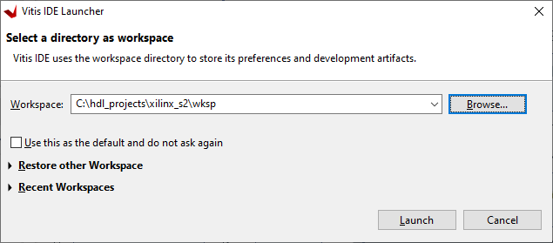
Lab 2: Understanding Vitis Project creation & Flow
Lab 2
Step 31 – From Tools select launch Vitis IDE, create a new workspace inside the project directory.

Slide 39
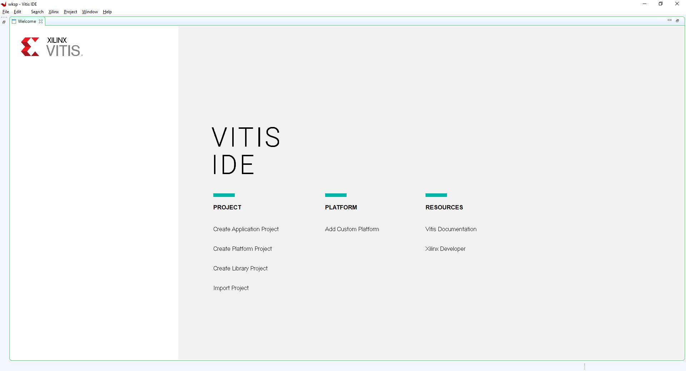
Lab 2: Understanding Vitis Project creation & Flow
Lab 2
Step 32 – Select Create Application Project

Slide 40
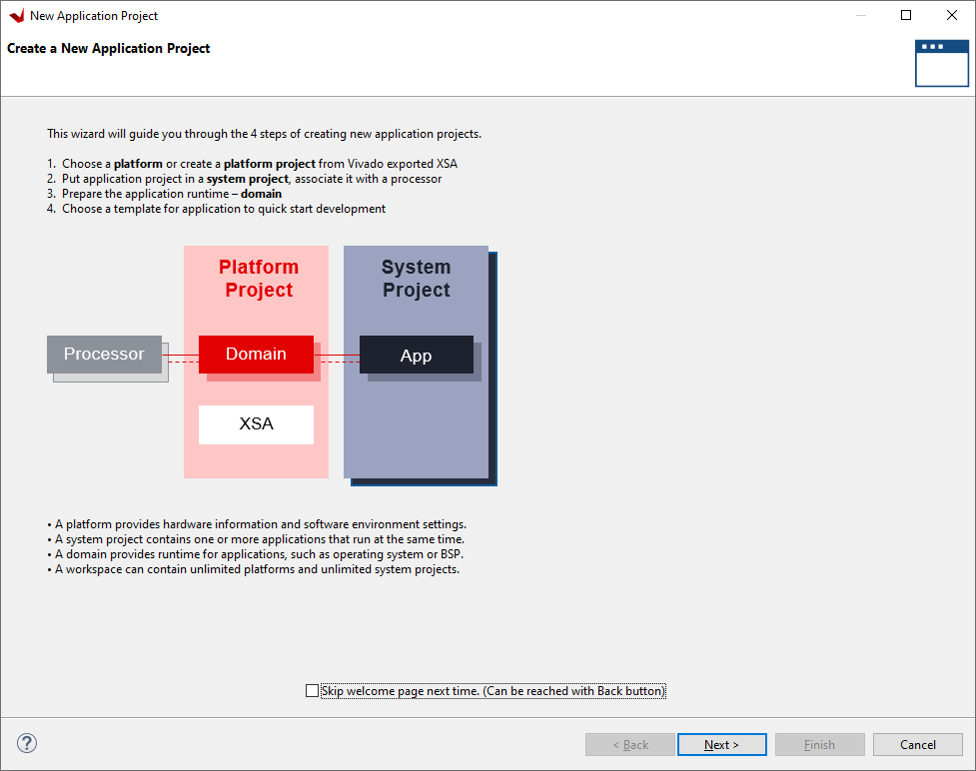
Lab 2: Understanding Vitis Project creation & Flow
Lab 2
Step 33 – Click next

Slide 41
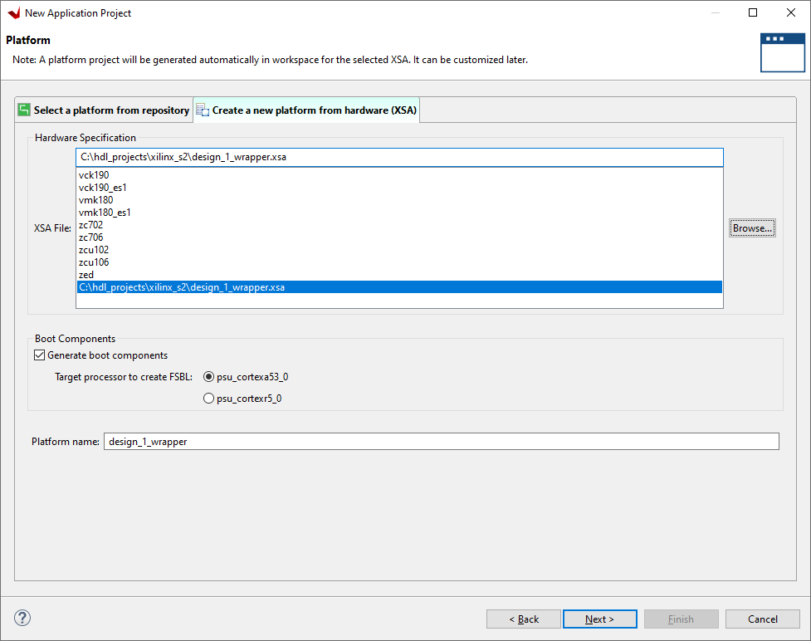
Lab 2: Understanding Vitis Project creation & Flow
Lab 2
Step 34 – Click Select Create a new platform from hardware, browse to the new project directory – select the XSA previously exported

Slide 42
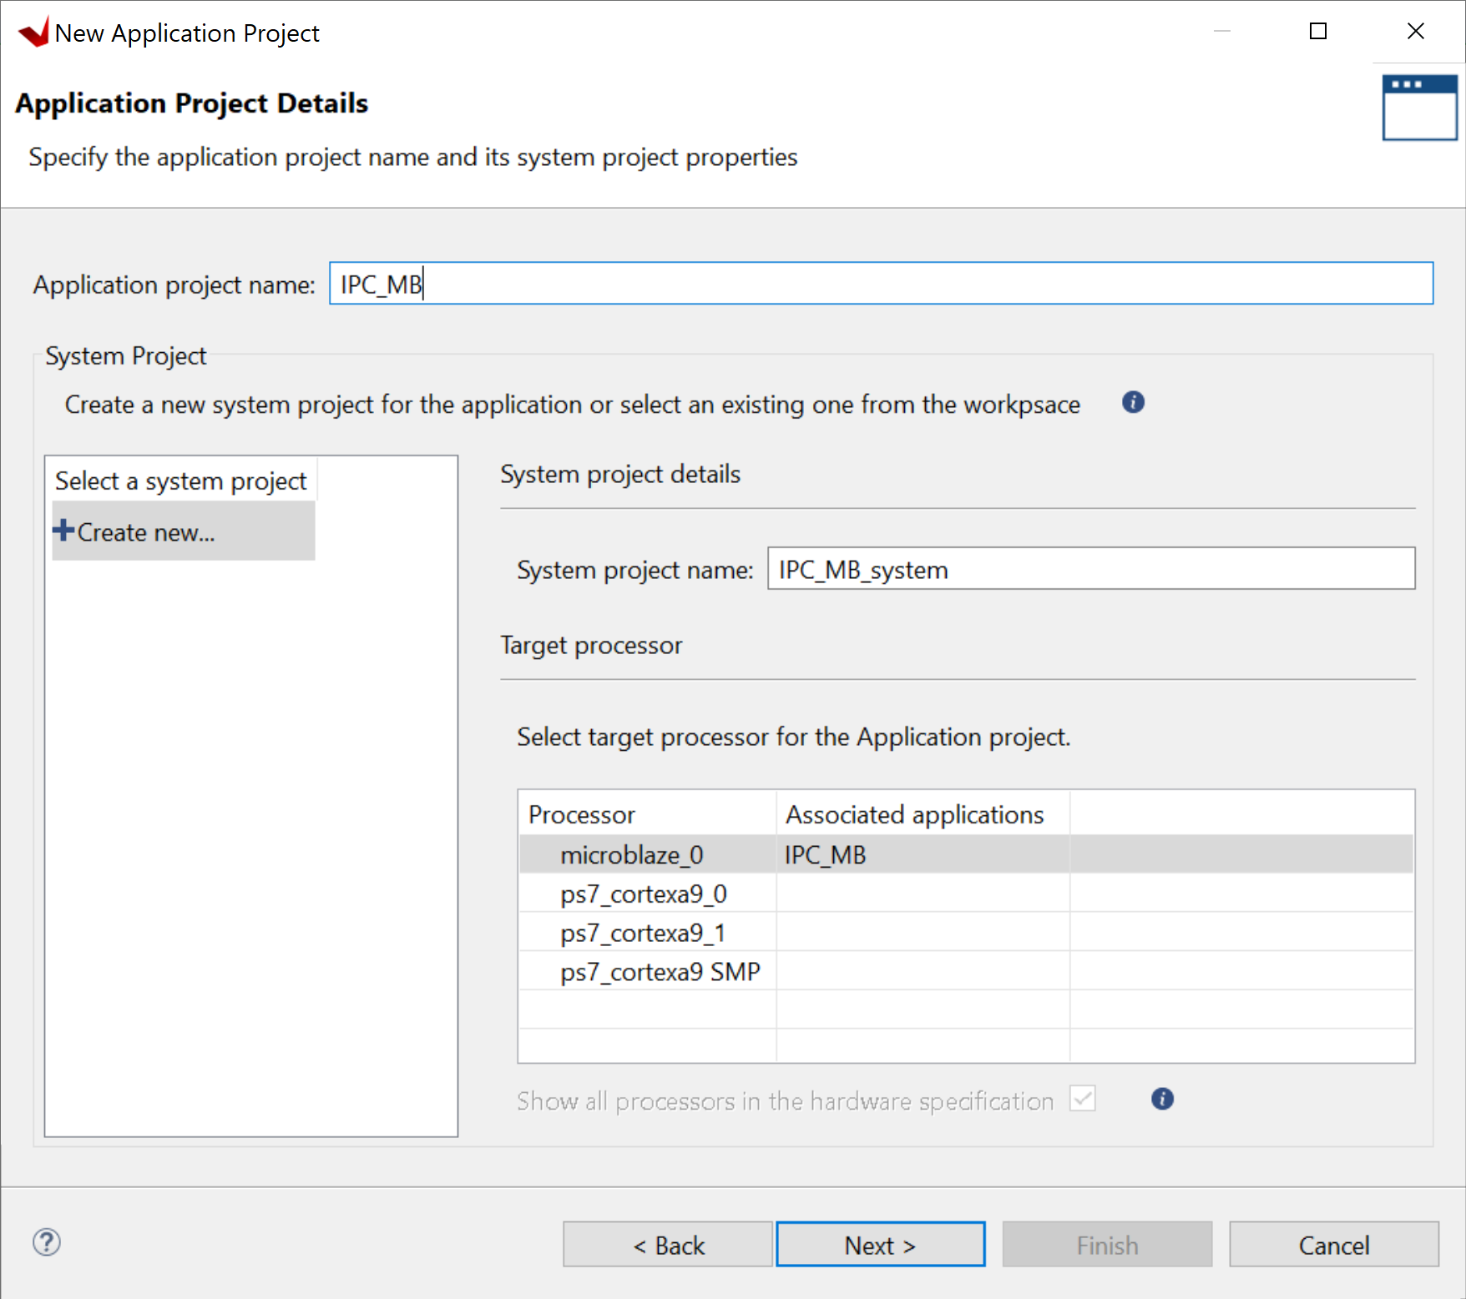
Lab 2: Understanding Vitis Project creation & Flow
Lab 2
Step 35 – Enter a project name and click next – This is for the MicroBlaze

Slide 43
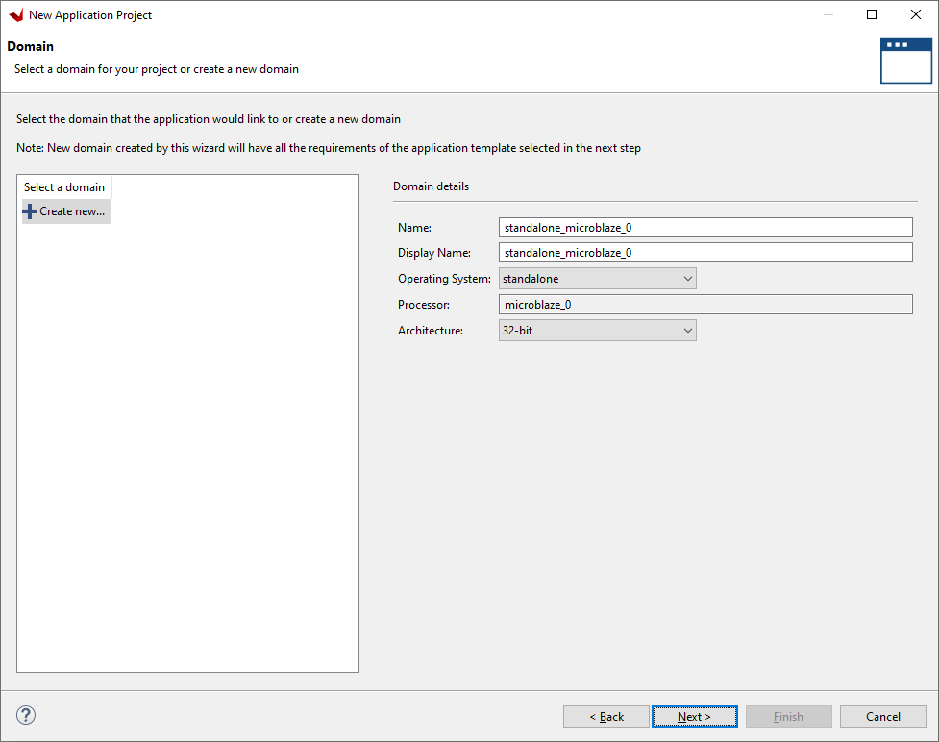
Lab 2: Understanding Vitis Project creation & Flow
Lab 2
Step 36 – Click on Next

Slide 44
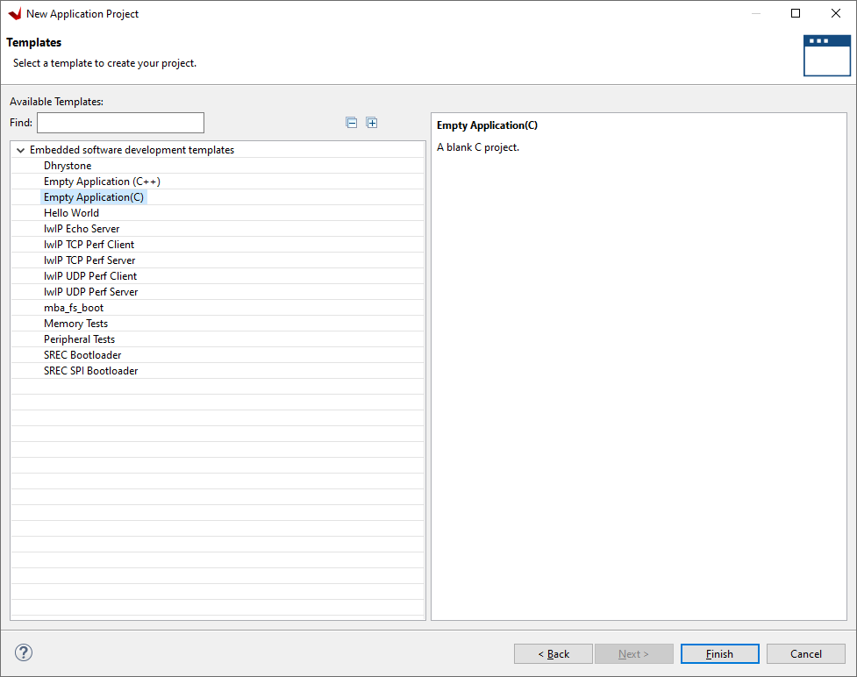
Lab 2: Understanding Vitis Project creation & Flow
Lab 2
Step 37 – Select Empty Application, click finish and project will be created

Slide 45
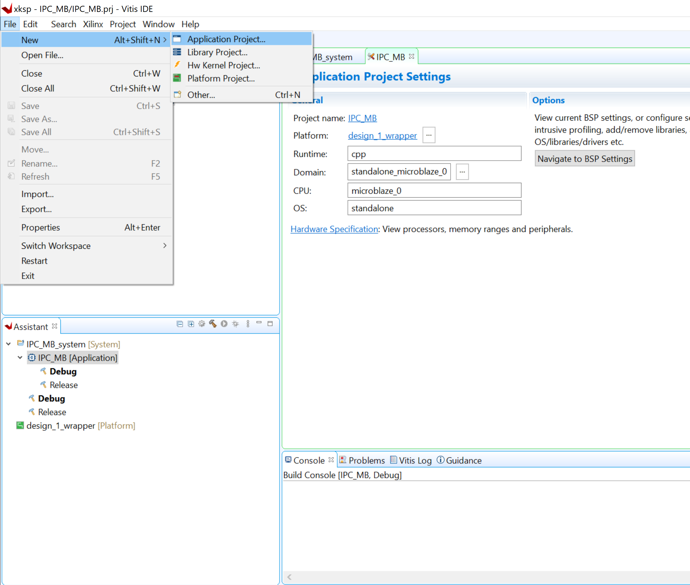
Lab 2: Understanding Vitis Project creation & Flow
Lab 2
Step 38 – From File select new application project

Slide 46

Lab 2: Understanding Vitis Project creation & Flow
Lab 2
Step 39 – Click next

Slide 47
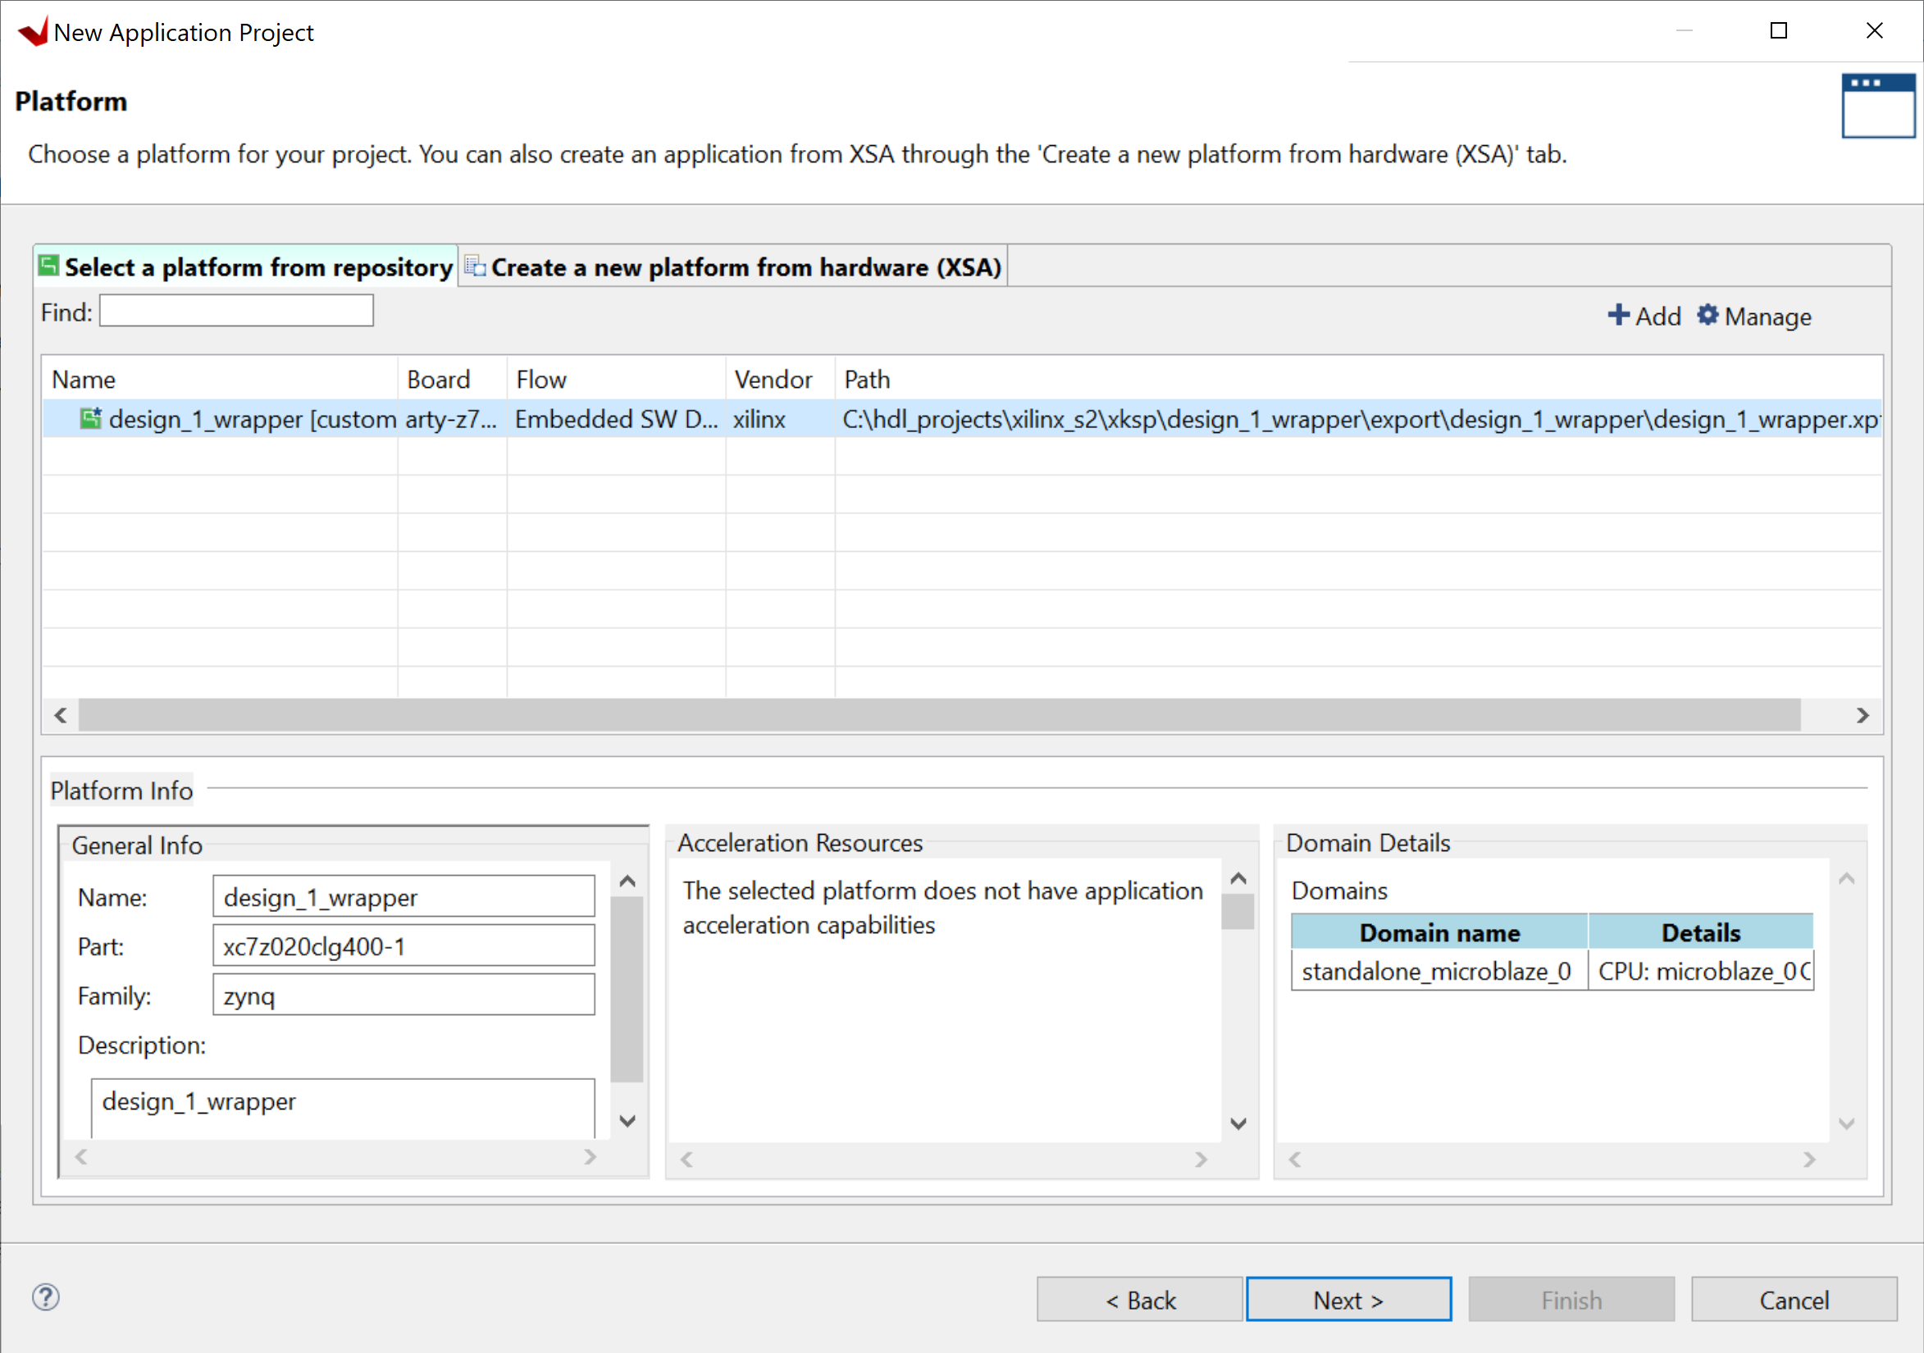
Lab 2: Understanding Vitis Project creation & Flow
Lab 2
Step 40 – Select the current platform and click next

Slide 48
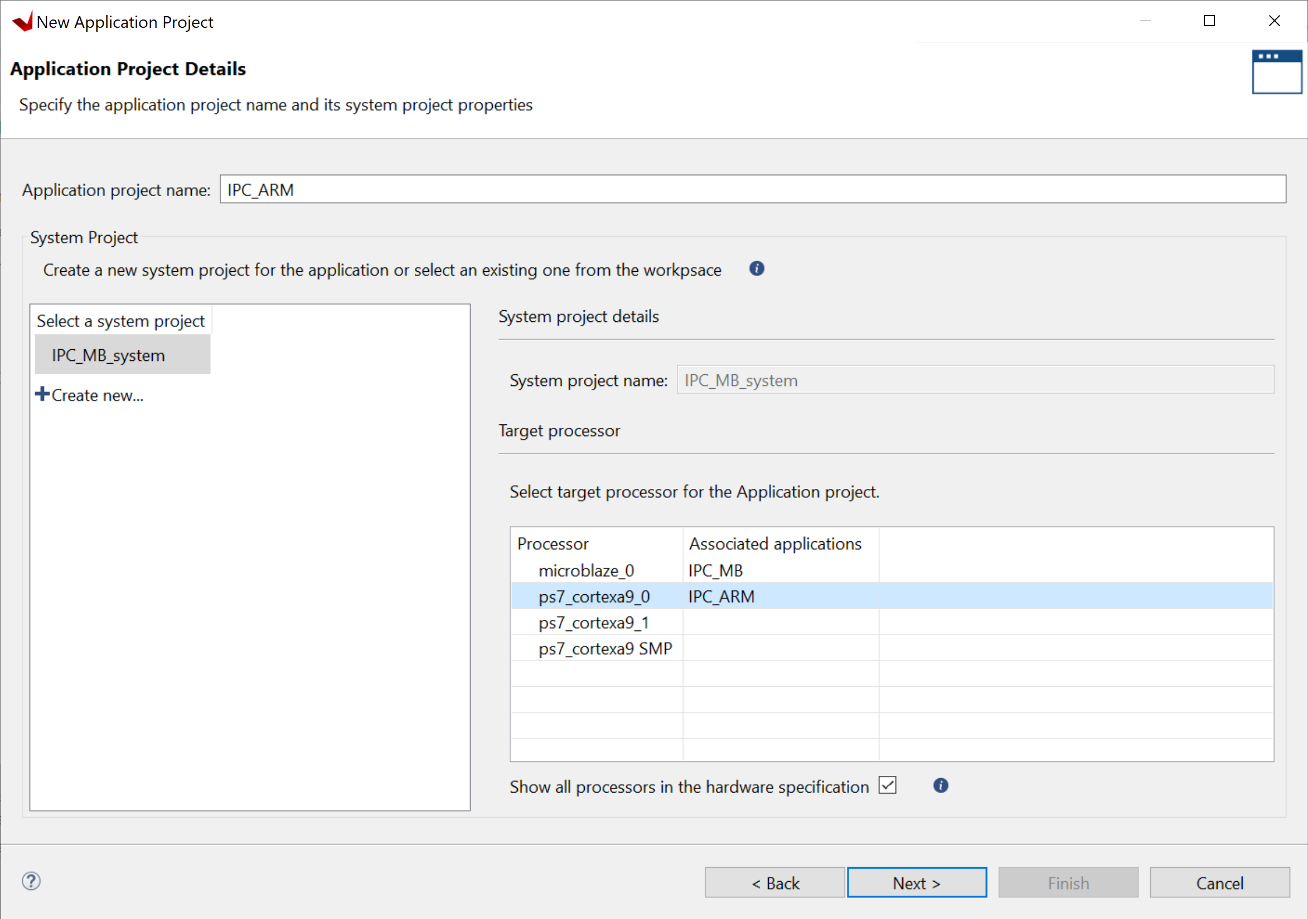
Lab 2: Understanding Vitis Project creation & Flow
Lab 2
Step 41 – Select the IPC System, ensure show all processors is selected, select processor ps7_cortex9_0 and enter a name IPC_ARM. Then click next

Slide 49
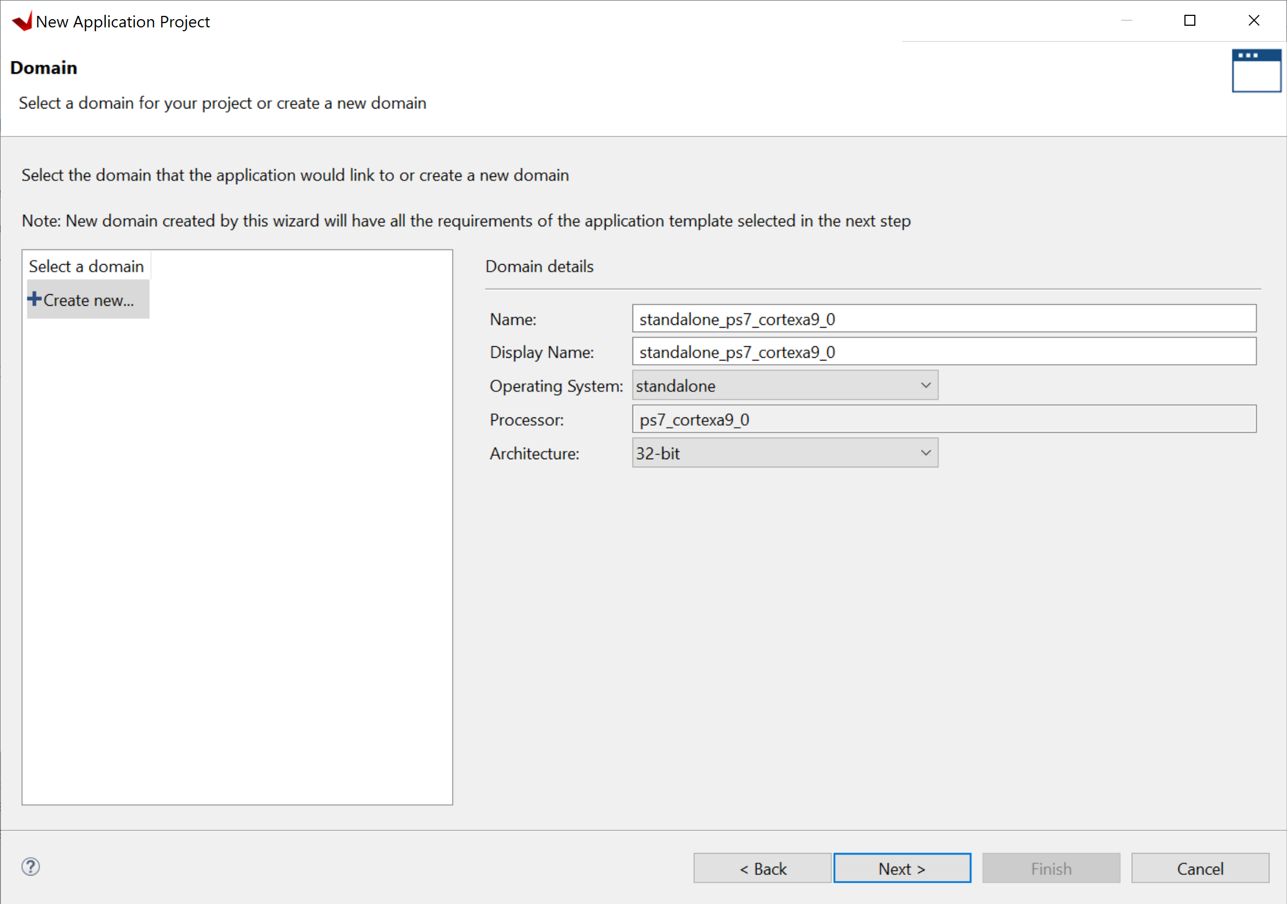
Lab 2: Understanding Vitis Project creation & Flow
Lab 2
Step 42 – Click on Next

Slide 50

Lab 2: Understanding Vitis Project creation & Flow
Lab 2
Step 43 – Select the Hello World template and click finish

Slide 51
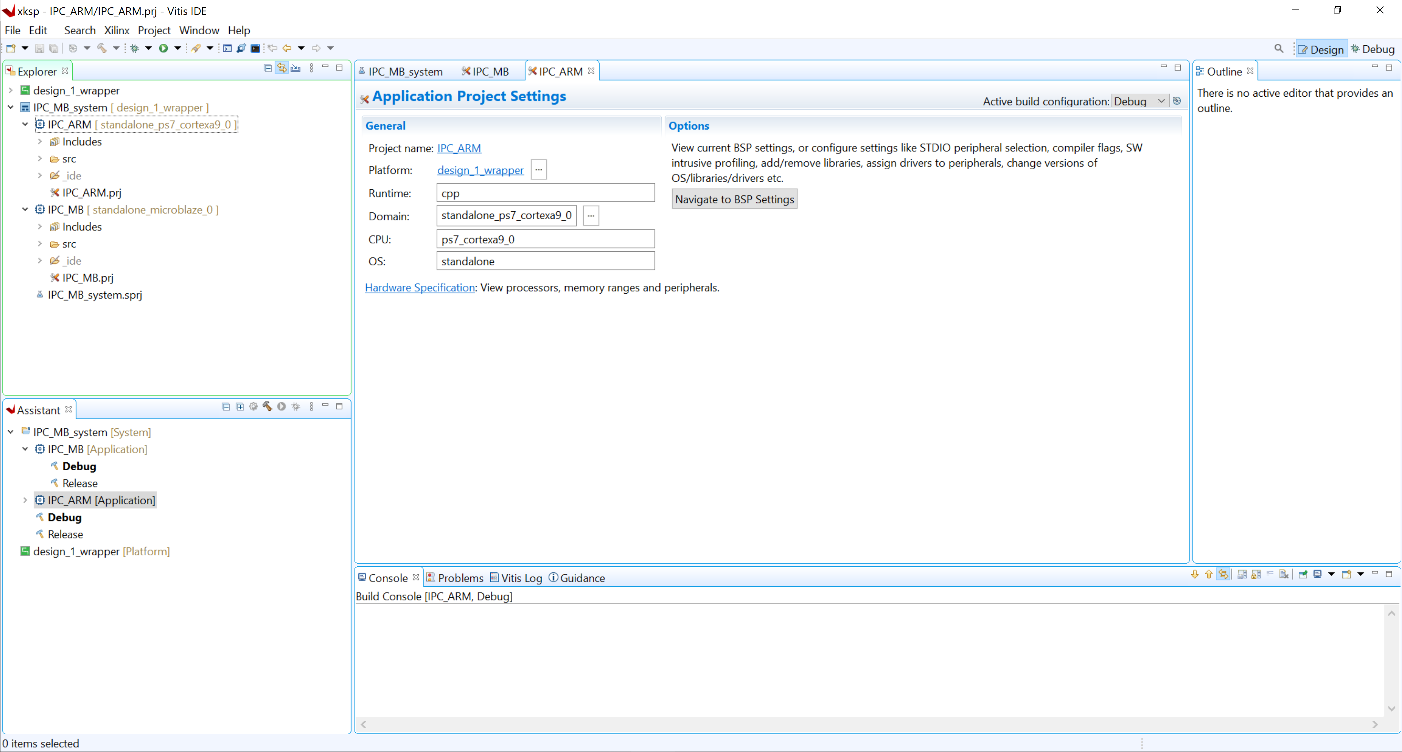
Lab 2: Understanding Vitis Project creation & Flow
Lab 2
Step 44 – You should now see two application projects along with the platform

Slide 52
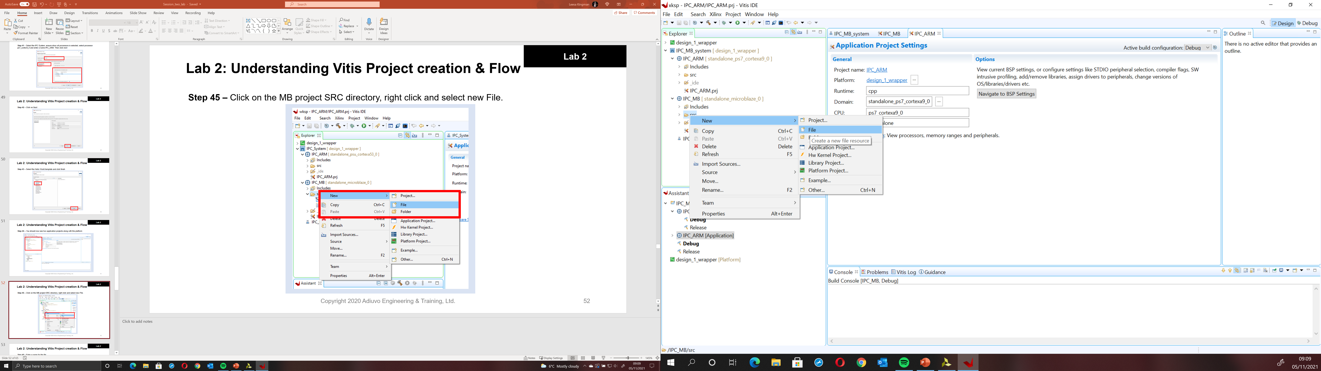
Lab 2: Understanding Vitis Project creation & Flow
Lab 2
Step 45 – Click on the MB project SRC directory, right click and select new File.

Slide 53
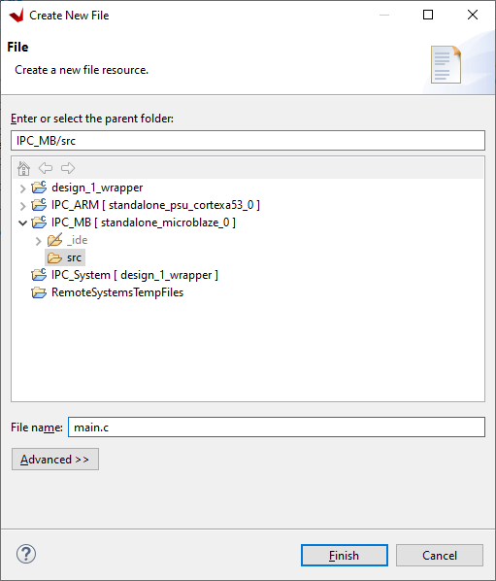
Lab 2: Understanding Vitis Project creation & Flow
Lab 2
Step 46 – Enter a name for the file then click finish

Slide 54
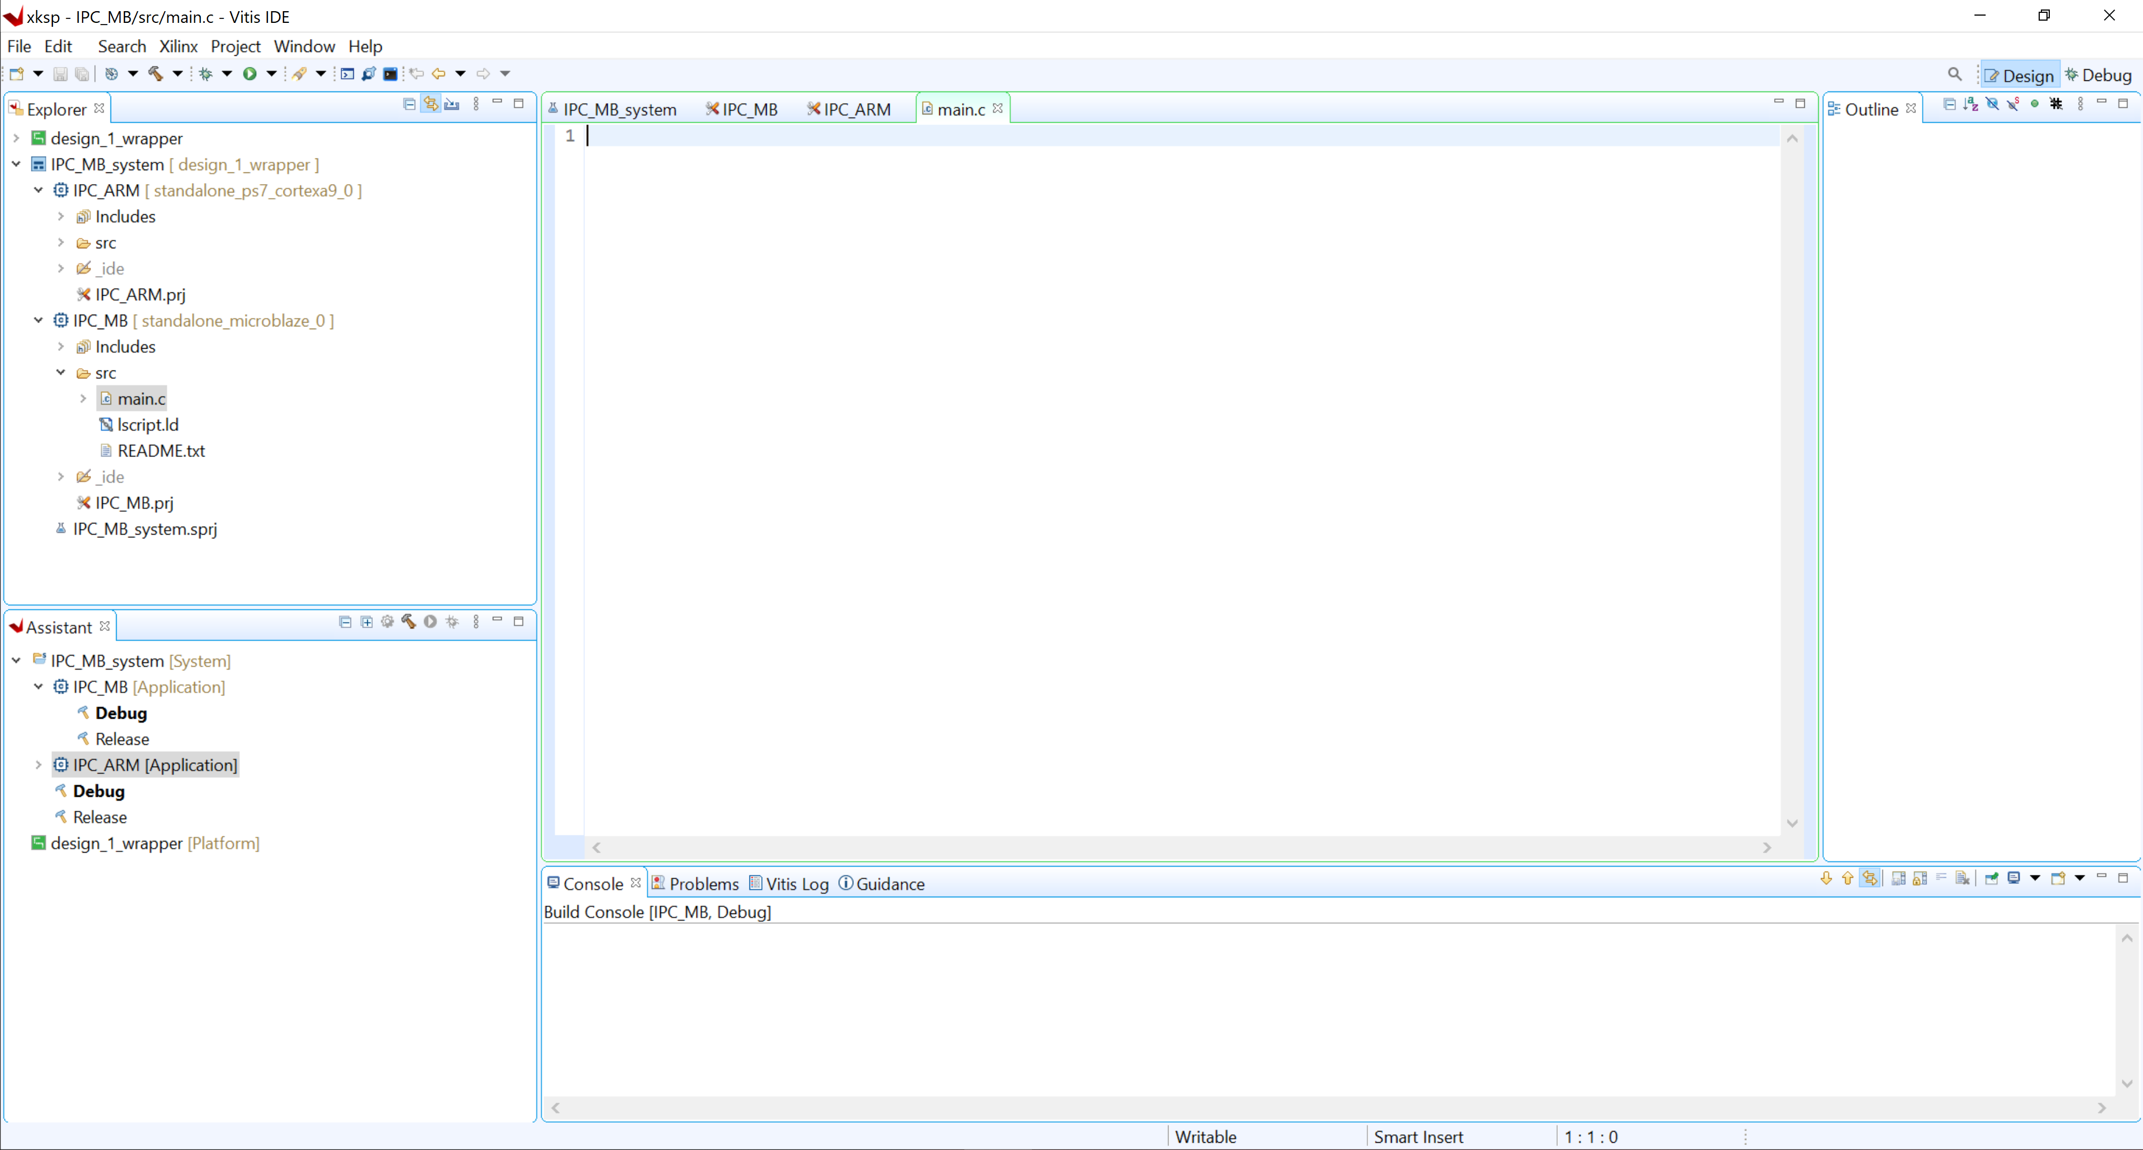
Lab 2: Understanding Vitis Project creation & Flow
Lab 2
Step 47 – Open the newly created file

Slide 55
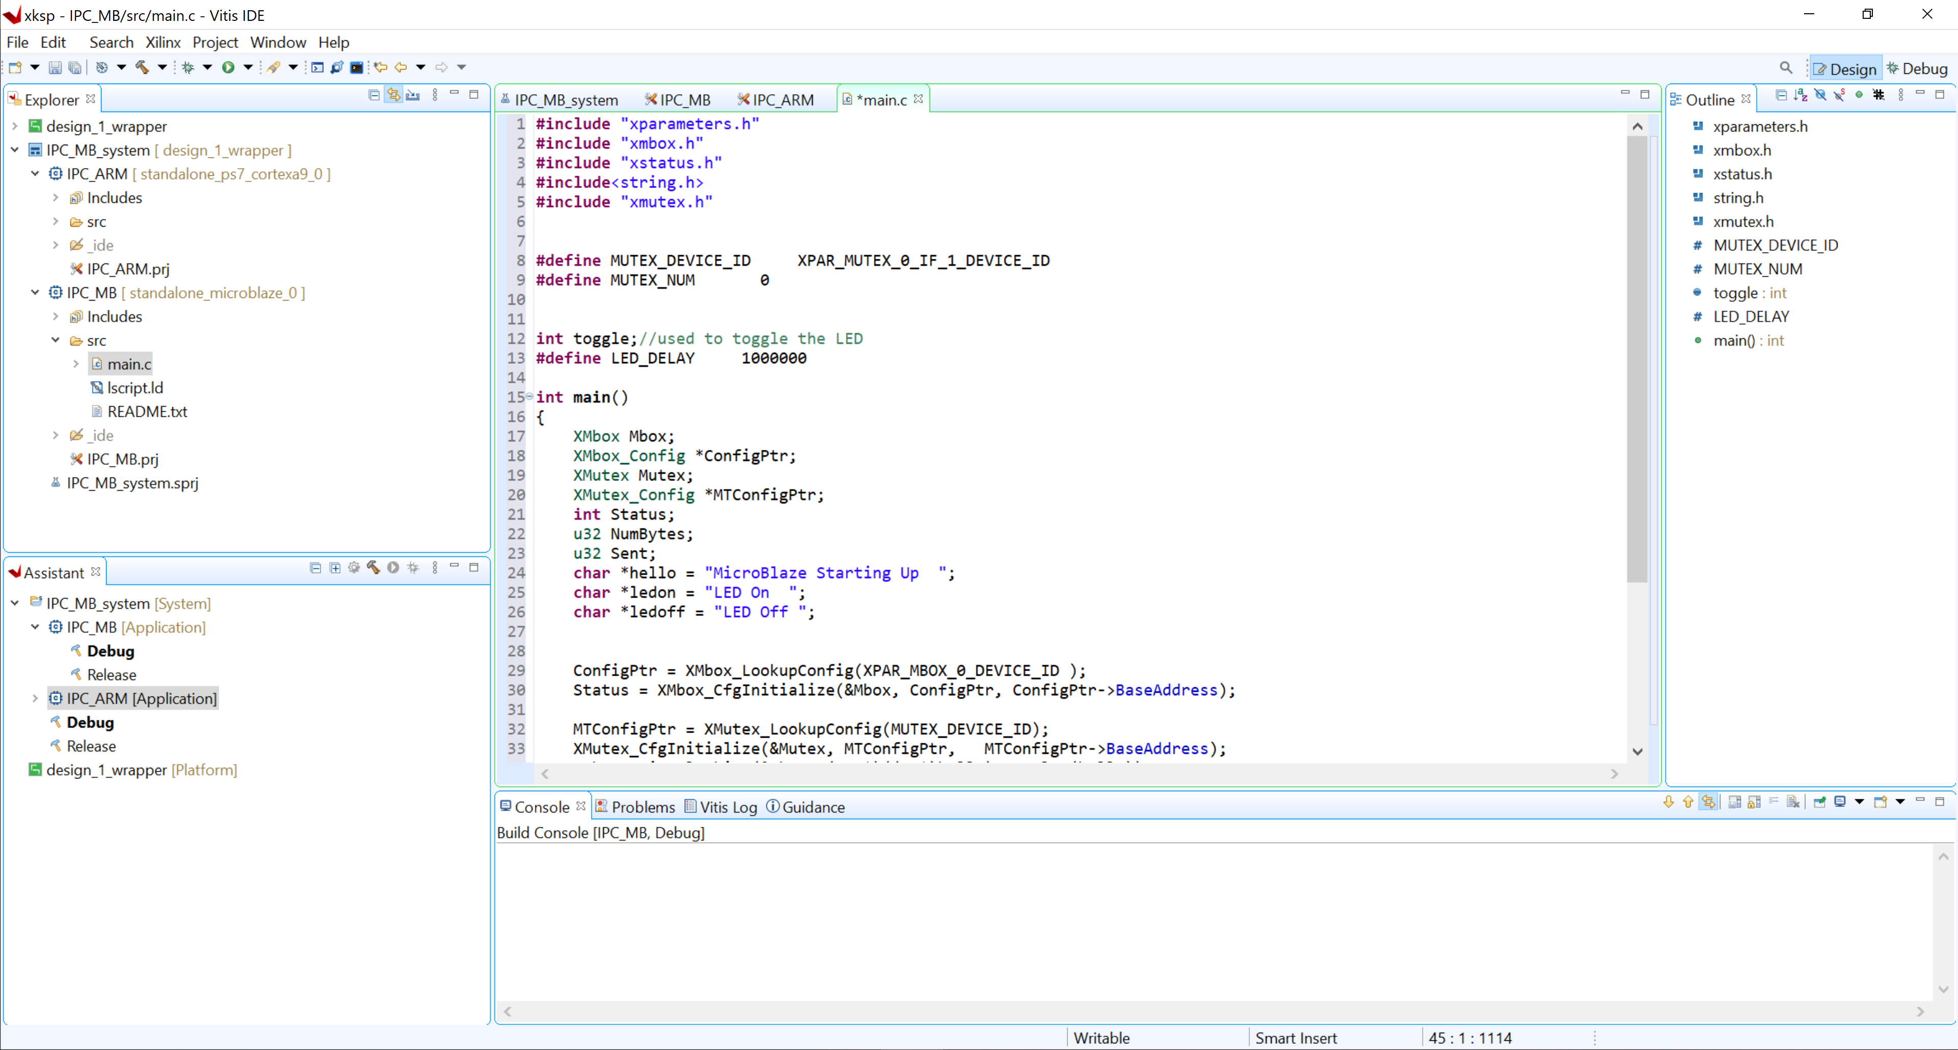
Lab 2: Understanding Vitis Project creation & Flow
Lab 2
Step 48 – Copy the main.c code into the empty file from the Github repo session two lab and save

Slide 56
Lab 2: Understanding Vitis Project creation & Flow
Lab 2
Step 49 – Click the hammer to build the code

Slide 57
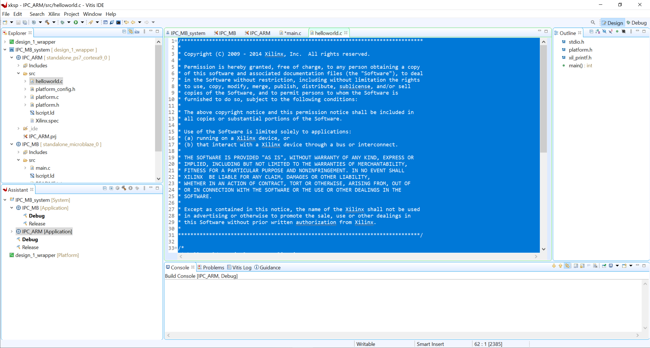
Lab 2: Understanding Vitis Project creation & Flow
Lab 2
Step 50 – Open the IPC_ARM hello world file and select and delete the entire contents

Slide 58
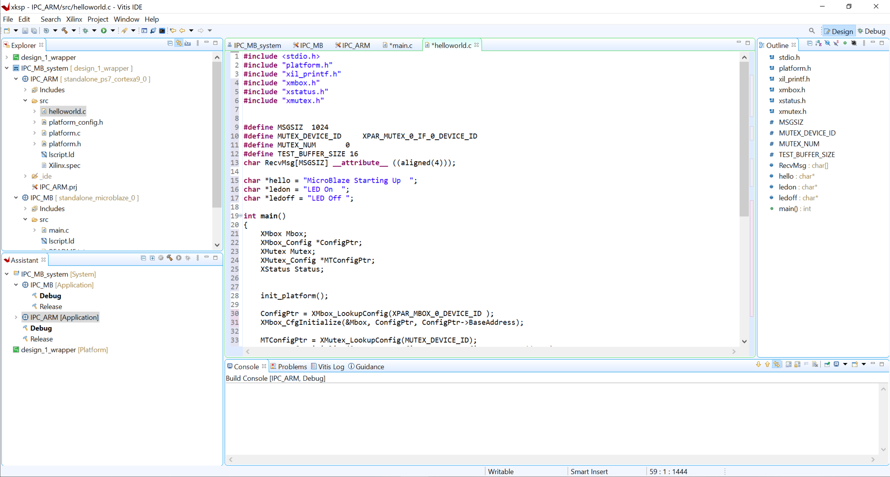
Lab 2: Understanding Vitis Project creation & Flow
Lab 2
Step 51 – Copy across the Zynq Application code from the Gitlab

Slide 59
Lab 2: Understanding Vitis Project creation & Flow
Lab 2
Step 52 – Click the hammer to build the code

Slide 60
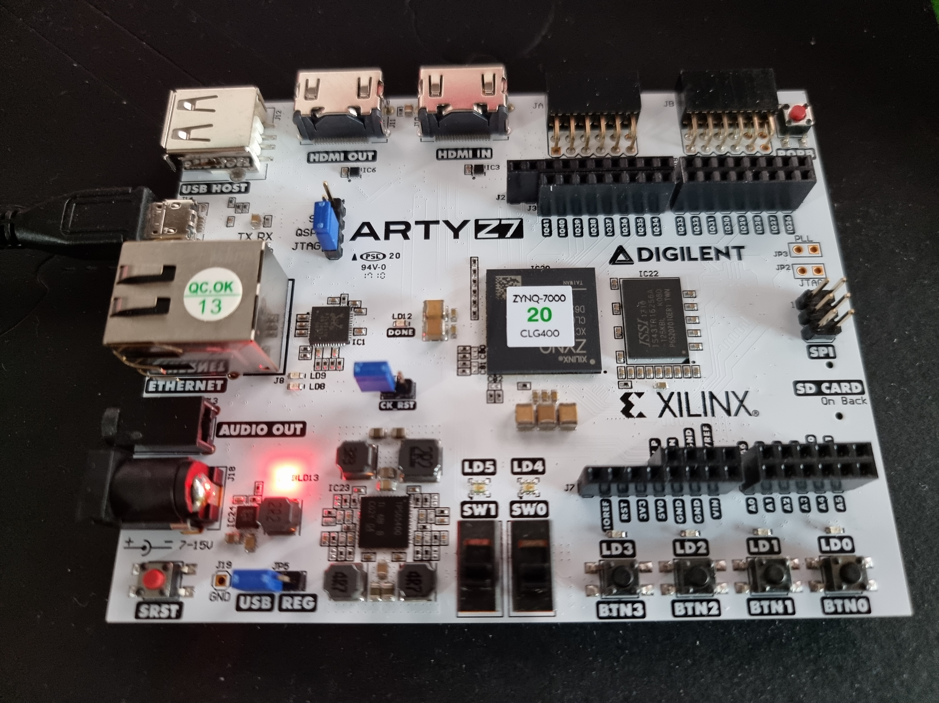
Lab 2: Understanding Vitis Project creation & Flow
Lab 2
Step 53 – Connect the USB to the ArtyZ7, Check the book Mode is JTAG. Power on the board.

Slide 61
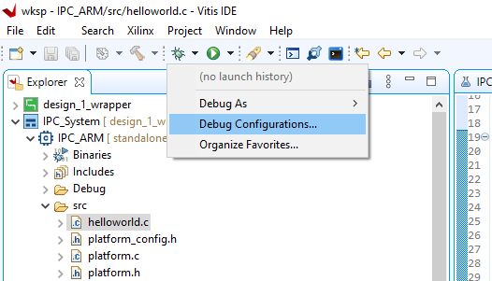
Lab 2: Understanding Vitis Project creation & Flow
Lab 2
Step 54 – From the debug icon, click on the arrow and select debug configuration

Slide 62
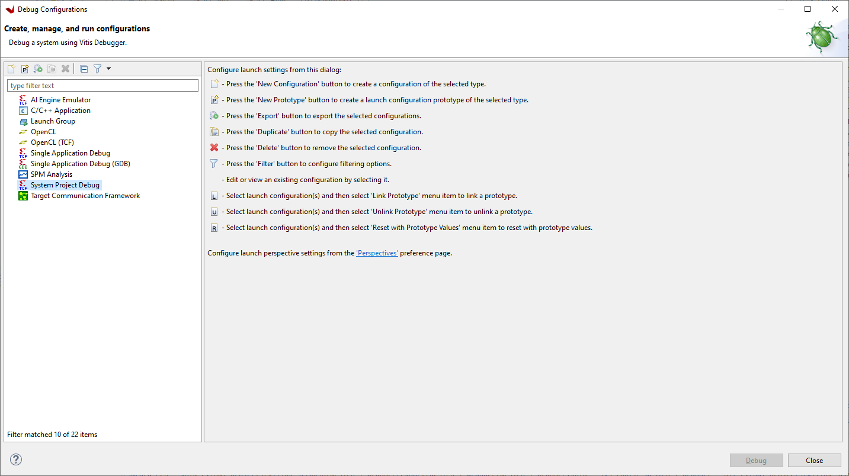
Lab 2: Understanding Vitis Project creation & Flow
Lab 2
Step 55 – Select System Project Debug and new

Slide 63

Lab 2: Understanding Vitis Project creation & Flow
Lab 2
Step 56 – Click on Target Set up – This should be auto populated. Notice the PS is configured, followed by the PL before both applications are downloaded. Click Debug

Slide 64

Lab 2: Understanding Vitis Project creation & Flow
Lab 2
Step 57 – Both applications will download and pause execution, click on the APU and hit run to start it

Slide 65

Lab 2: Understanding Vitis Project creation & Flow
Lab 2
Step 58 – Select the MB application and start that executing

Slide 66

Lab 2: Understanding Vitis Project creation & Flow
Lab 2
Step 59 – Click the Vitis Serial Terminal window and click +

Slide 67

Lab 2: Understanding Vitis Project creation & Flow
Lab 2
Step 60 – Check the settings below and click ok

Slide 68

Lab 2: Understanding Vitis Project creation & Flow
Lab 2
Step 61 – The following results will be observed

